Slide 1
Education for Justice (E4J)
Integrity and Ethics
Module 11: Business Integrity & Ethics

Slide 2
Agenda
Class overview (10 minutes)
Applying ethics in business and the business case for ethics (40 mins)
Discourse on managing business ethics (20 mins)
Introducing codes of conduct and codes of ethics (30 mins)
Class exercises (70 mins)
Wrap up (10 mins)

Slide 3
Learning Outcomes
Upon completion of this module students should be able to:
Explain why integrity and ethics are important for both corporations and individuals in the world of business
Present the business case for the importance of integrity and ethics in business (both in terms of driving long-term value creation and protecting value)
Describe the key components required to design, implement, and support a successful integrity and ethics programme in any business
Suggest ethical management approaches for businesses of various characteristics in terms of size, legal status, or level of complexity

Slide 4
What is Business ethics ?
Business ethics : the study of business situations, activities, and decisions where issues of right and wrong are addressed (Crane& Matten, 2009)
Business ethics is also known as corporate ethics. It is a form of applied ethics or professional ethics that examines ethical principles and moral or ethical problems that arise in a business environment (Wikipedia, 2017).
Morality is concerned with the norms, values and beliefs embedded in social processes which define right and wrong for an individual or a community.

Slide 5
Fostering culture of integrity
Part and parcel of organizational ethics is fostering a culture of integrity through:
Motivating employees individually to act ethically;
Promoting integrity and codes of ethics through modeling, mentoring and other activities;
Ensuring that performance management and reward systems do not contradict or undermine core values of a business;
Demonstrating to employees that the business is willing to "walk the talk“;

Slide 6
Applying ethics in business and the business case for ethics
Ethical principles for business
Solidarity
Efficiency
Rationality
Fairness
Refraining from willingly harming others
Role-responsibility

Slide 7
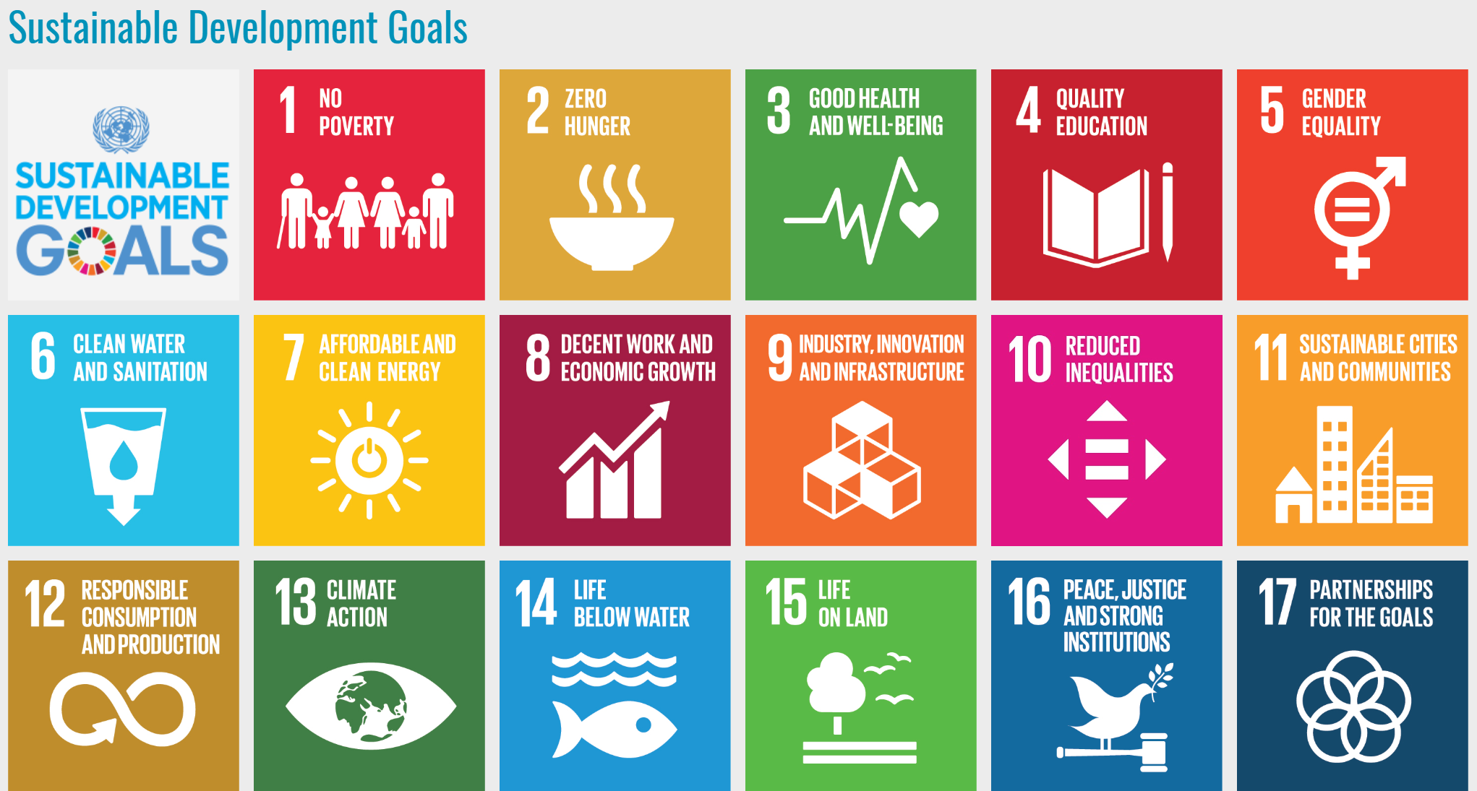
Applying ethics in business and the business case for ethics (exercises)
Exercise 1: Mapping business contributions to the SDGs
Exercise 2: Convince your supervisor that ethics pays (role play)

Slide 8
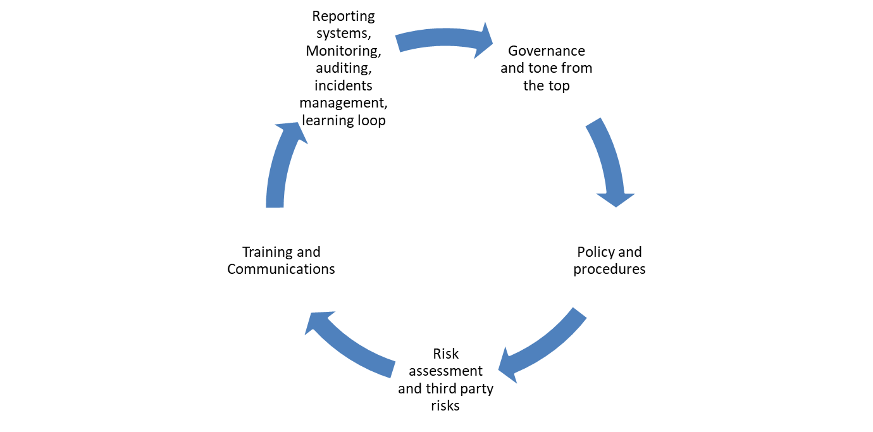
Discourse on managing business ethics
Establishing a business ethics management system:
An effective business integrity and ethics programme include:
Internal measures
External measures
Collective measures

Slide 9
Introducing codes of conduct and codes of ethics
Purpose of a Business Code?
Selection of the topics in a Code
Succesfull implementation of Code
Limitations
Global Codes?

Slide 10
Class exercises
Exercise 3: Analysis of Codes (case study)
Exercise 4: How to communicate codes?

Slide 11
Core reading
MacDonald, Chris and Alexei Marcoux (n.d.). Concise Encyclopedia on Business Ethics. Journal Review Foundation. Available from https://conciseencyclopedia.org/
Elegido, J.M. (1996). Fundamentals of Business Ethics: A Developing World Perspective. Ibadan, Nigeria: Spectrum Books Limited. Available from http://www.lbs.edu.ng/sites/faculty_research/elegido_juan_publications
Paine, Lynne S (1994). Managing for organizational integrity. Harvard Business Review (March-April), pp. 106-117. Available from https://hbr.org/1994/03/managing-for-organizational-integrity

