Slide 1
World Drug Report 2014 –
Chapter II:
Precursor chemicals
June 2014
Notes:
Precursor control has emerged as an additional supply reduction strategy following the 1988 UN Convention against Illicit Traffic in Narcotic Drugs and Psychotropic Substances.
Control of precursors strengthened due to
a number of CND and ECOSOC resolutions,
the 1998 and 2009 Political Declarations and their related Action Plans
and the work done by INCB.
Precursor control has become more relevant as growing proportions of the drugs found on the market are nowadays synthetic drugs.
The chapter is organized as follows:
Introduction
What are precursor chemicals?
Precursor chemicals in stricto sensu:
Chemicals that become incorporated at the molecular level into a narcotic drug or psychotropic substance
Reagents
Chemicals that react with, or take part in the reaction of another substance during the manufacture of a drug. They do not become part of the molecular structure of the end-product.
Solvents
Liquid chemical substances used to dissolve or disperse one or more substances. They doe not ‘react’ with other substances and are not incorporated into the molecular structure of the end product. They are typically used to purify the end product.
This scientific distinction, however, does not entail legal consequences. Article 12 of the 1988 Convention, the legal basis for precursor control at the international level, only speaks of ‘substances frequently used in the illicit manufacture of narcotic drugs or psychotropic substances’.
In the Political Declaration and the related measures to enhance international cooperation to counter the world drug problem adopted by the General Assembly in June 1998, the term “precursors’ was broadened to encompass all chemicals controlled under the 1988 Convention.
Potential vulnerabilities of the chemical industry to the diversion of precursor chemicals
Response by the international community to prevent diversion of precursor chemicals –
Starting with the League of Nations conventions; main foundation: 1988 Convention
Patterns and trends in production, trade and trafficking in precursor chemicals
Key precursors used in the illicit manufacture of drugs
Licit use
International trade
Trafficking
Effects of precursor control on the supply of illicit drugs
Reactions of clandestine operators facing stronger precursor controls
Concluding remarks

Slide 2
Regional distribution of the value added of the global chemical industry, 1990-2010
Source: UNODC estimates based on World Bank, Indicators, August 2013.
Notes:
VULNERABILITIES
Over the past century, the chemical industry has been one of the main economic growth sectors, and it continues to
grow strongly, both in volume and in geographical terms, involving an ever larger number of players. This and the increasing number of intermediaries provide, however, greater opportunities for diversion.
The production output of the chemical industry, expressed in constant US dollars, almost doubled between 1990 and 2010, and rose more than fourfold between 1960 and 2010 to approximately $3,800 billion.
The value-added of the chemical industry – expressed in constant US$ - grew from $620 billion in 1990 to $1,110 billion in 201.
Click:
Over the 1990-2010 period the proportion of the value-added of the global chemical industry has been
- declining in the Americas,
declining and in Europe,
but rising in Asia.
Asia accounted
For 35% of global value-added of chemical industry in 2010,
for 44% of global production output in 2010 and
for even 52% of global sales of the chemical industry in 2011

Slide 3
Global exports of the chemical industry, 1990-2012
Growth in exports, output and value-added of the chemical industry (based on constant US$)
Sources: UNODC estimates based on World Bank Indicators, UNIDO Industrial Database and UN COMTRADE (SITC Rev.3).
Notes:
Chemical exports grew strongly in the 1990s and even stronger in the first decade of the new millenium following an ongoing trade-liberalisation and the broadening of the membership (China !) of the World Trade Organisation (WTO) at the beginning of the 21st century.
The value added of the chemical industry grew 3.5% per year over the 2000-2010 period. This was more than the growth of the value added of manufacturing as a whole (2.8% per year over the 2000-2010 period) and more than overall economic growth (2.5% per year over the 2000-2010 period).
Output of the chemical industry grew stronger than the value added.
Chemical exports grew stronger than the output of the chemical industry.
The observed stronger growth of output as compared to value-added suggests a trend of companies redefining their core products and spinning off non-core production and services to new companies. This can be explained by a reduced vertical integration of the chemical industry, mainly as a consequence of the emergence of new production sites in developing countries, particularly in Asia.
One side-effect has been increased intra-industry trade in chemicals across continents which increases the risk of diversion of chemicals used in the clandestine manufacture of drugs.
The risk is further exacerbated by a growing number of intermediary countries and brokers involved in the chemical trade.
In fact, 40% (!!) of the countries export more chemicals that they produce.
This means that there are nowadays important trade flows of chemicals that do not go directly from producing to consuming countries. Instead, they transit various countries before arriving in the final destination countries. The more brokers and other intermediaries are involved in the supply chain, the larger are the possibilities of diversion and the weaker will be the effective application of the ‘know your customer’ principle, set out in the 1998 Political Declaration and the related ‘measures to enhance international cooperation to counter the world drug problem’ .
Potential vulnerabilities of diversion of chemicals have been thus increasing over the last two decades, notably over the last decade.
The problem might have thus exploded if no precursor control at the national and international level had been put in place.

Slide 4
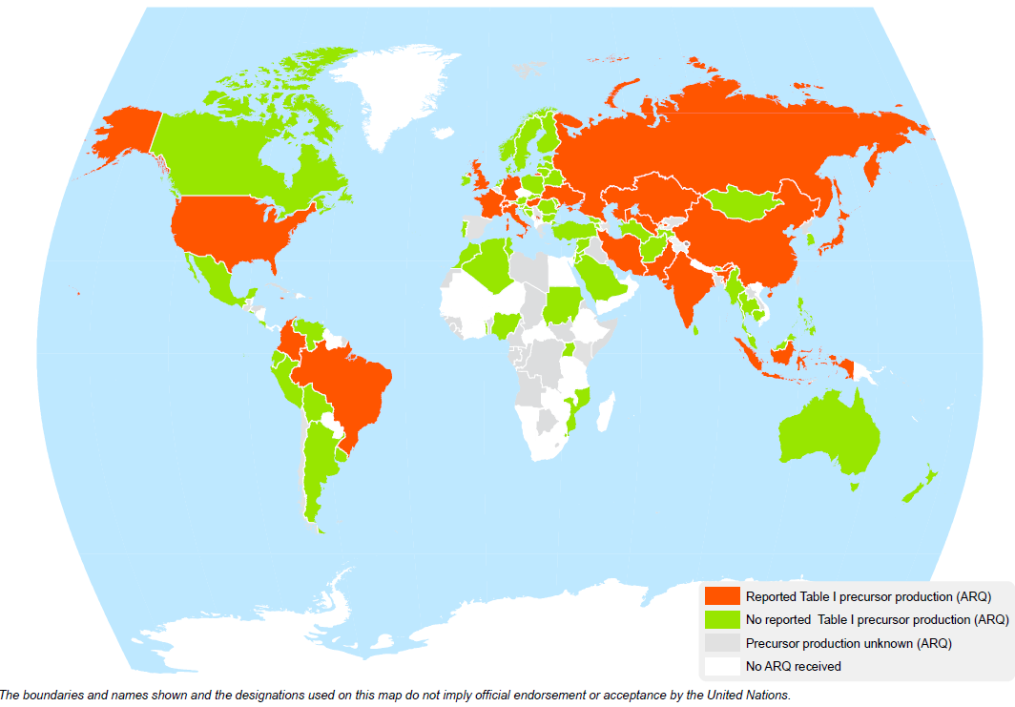
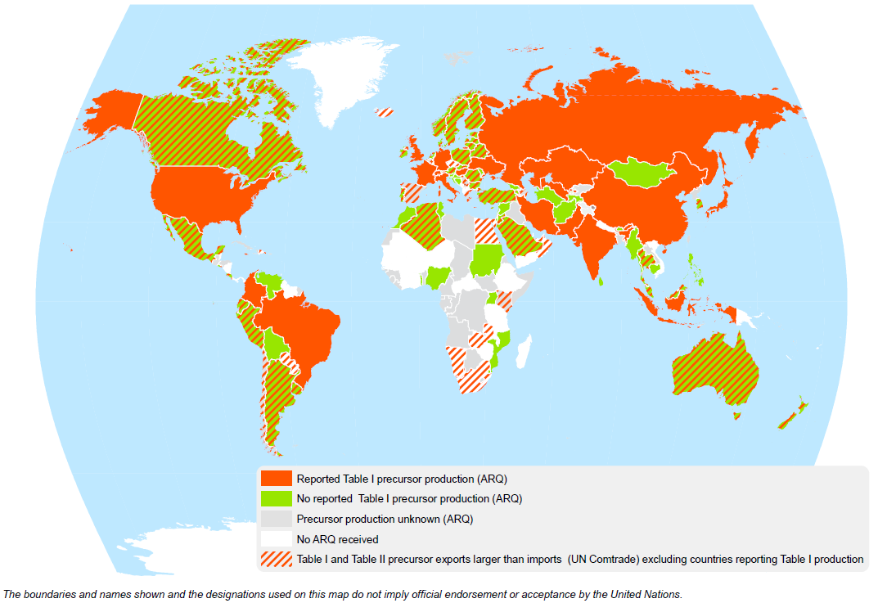
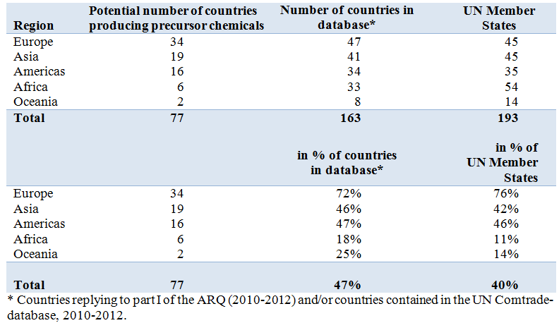
Potential manufacture of precursor chemicals (Table I and Table II), 2010-2012
20 countries officially reported manufacture of Table I precursors to UNODC over the 2010-2012 period
(8 in Asia, 8 in Europe and 4 in the Americas).
77 potential precursors producing countries account for 77% of the world population
Sources: UNODC, Annual Reports Questionnaire data and UN COMTRADE data.
Notes:
Countries asked in the ARQ on information of whether Table I precursors are produced in their country. 20 countries reported production over 2010-2012 period.
Third click:
Shaded line shows countries where exports of any specific precursor (out of 23 internationally controlled) exceeded imports over the 2010-2012 period); indirect indication of domestic production.
Including countries reporting Table I production.

Slide 5
Regional distribution of trade in internationally controlled precursors
(Table I and Table II), 2010-2012
Source: COMTRADE data.
Notes:
Most licit precursor exports and imports are affected by countries in Asia
If only the net exporting countries are analyzed, i.e. countries showing higher exports than imports of precursor chemicals, the dominance of Asia (59%) becomes even more marked.

Slide 6
Global (legal) exports of precursor chemicals in constant 2012 US dollars, 1996-2012
Change: 1996-2012:
Table I precursors: +35%
Table II precursors: 3½ times
Source: COMTRADE data.
Notes:
Growth in exports of the less controlled Table II precursor chemicals has been far larger than exports of the more controlled Table I precursors.
In 2012 exports of all precursor chemicals accounted for 0.5% of all chemical exports.
Table I precursors accounted for 7% and Table II precursors for 93% of all precursors exports.
The largest Table I exports were
acetic anhydride (used in the manufacture of heroin and of P-2-P out of phenylacetic acid, typically used in North America for meth production), followed by
potassium permanganate (used in the manufacture of cocaine),
pseudoephedrine (used in the manufacture of methamphetamine) and
piperonal (used in the manufacture of ecstasy).

Slide 7
Global seizures of Table I precursors, 1989-2012
*cocaine precursor: potassium permanganate; heroin precursor: acetic anhydride; amphetamine-type stimulants (ATS) precursors: P-2-P, phenylacetic acid, ephedrine, pseudoephedrine, norephedrine, 3,4-MDP-2-P, safrole, isosafrole, piperonal; others: lysergic acid; ergometrine, ergotamine, N-Aceylanthranilic acid
*preliminary data for 2012; data may still rise once additional information becomes available.
Source: INCB, 2013 Precursors report, New York 2014 (and previous years).
Notes:
The main growth of Table I precursors was linked to ATS precursors.
The peak in 2011 was primarily due to phenylacetic acid seizures in North America. Phenylacetic acid is used to produce P-2-P, which – in north America – is nowadays mainly used for the clandestine manufacture of methamphetamine.

Slide 8
Effects of precursor control
Seizures and stopped shipments
Seizures of Table I precursors: 12-fold increase 1990-92 and 2010-2012
Stopped precursors shipments even more important than precursors seizures
Additional measurements of ‘effectiveness’:
Interception rate (15% for diverted potassium permanganate and acetic anhydride over the 2007-2012 period)
Reduction of drug availability
Seizures of precursor chemicals compared to drug seizures
Seizures of ecstasy precursors: 18% more than ecstasy seizures (2007-2012);
Seizures of amphetamines precursors: > 2-fold seizures of amphetamine and meth-
amphetamine (2007-2012)
Cases of reductions in supply of drugs linked to precursors control:
LSD, methaqualone, ecstasy
Impact of precursor control on prices:
Licit: $1-1.5 per litre of acetic anhydride; Afghanistan: $8 in 2002; ≈ $200 ($157-$221) in 2013
Notes:
Note:
Stopped shipments:
Prime objective of precursor control are not precursor seizures but the prevention of diversion of precursor chemicals towards clandestine laboratories;
Thus 943,000 litres of acetic anhydride were either stopped or identified as suspicious, i.e. nearly double the 551,000 litres of acetic anhydride globally seized over the 2008-2011 period.
Seizures of precursor chemicals compared to end-products
The analysis of precursor seizures, expressed in end-product equivalents, shows that ecstasy precursor seizures over the 2007-2012 period exceeded ecstasy seizures by 18%;
Seizures of precursor of amphetamine and methamphetamine were even more than 2 fold the seizures of amphetamine and methamphetamine over the 2007-2012 period.
Cases of reduction
There are indications that in the case of LSD, methaqualone and ecstasy improved precursor control actually helped to reduce production.
In Europe, LSD use fell by ¾ over the last decade among young adults; similarly in the USA, LSD prevalence fell by 75% among 12th grade high-school students over the 1996-2013 period; this appears to have been linked to falling availability. Perceived availability of LSD fell 54% among 12th grade students over this period. Global exports of the main LSD precursors (lysergic acid, ergotamine and ergometrine) fell by 78% over the 1996-2012 period).
Use of ecstasy fell by almost half in Europe over the last decade in the USA it fell 58% among 12th graders between 2000 and 2013; this went hand in hand with a decline of perceived availability of 32%. Overall exports of ecstasy precursor at the global level fell by 41% between 1998 and 2012.
Prices
Prices of acetic anhydride in Afghanistan rose from $8 per litre in 2002 to more than $430 in 2011 before declining – for best quality acetic anhydride to $221 in 2013 or overall $157 (average of all acetic anhydride of all qualities across Afghanistan).
- The rise in prices over the 2002-2011 period can be linked to improvements in precursor control.
- The fall in prices between 2011 and 2012/2013 may be linked to a fall in global seizures in 2012 and a deteriorating security situation which facilitates smuggling of acetic anhydride into Afghanistan.
Nonetheless, prices are still far higher than the licit prices of acetic anhydride of $1 to $1.5 per litre.

Slide 9
Reactions of clandestine operators
More sophisticated ways to obtain precursor chemicals
Creation of specialized groups to obtain the precursors chemicals
Creation of front companies
Identification of weak links in the control system (e.g. countries in Africa or territories such as Taiwan province of China which are not making use of pre-export notifications (PEN) and are not participating in the precursors communication incident system (PICS))
Identification of weaknesses at the national level (diversion from domestic sources)
Use of the Internet
Use of pharmaceutical preparations (containing ephedrine and pseudoephedrine)
Use of substitute chemicals and pre-precursors (APAAN, esters of phenyl-acete (ethyl phenylacete, methyl phenylacetate), 3,4-MDP-2-P methyl glycidate, methylamine, etc.)
Production of New Psychoactive Substances (NPS)
Notes:
Reactions:
The fact that clandestine operators reacted to international precursor control is an indirect proof that it has an impact and is being taken seriously.
Use of pharmaceutical preparations:
Such preparations have been de-facto exempted from international control in the 1988 Convention.
Only in subsequent resolutions and in the 2009 Political Declaration and its Plan of Action countries were encouraged to include
controls to such substances as well.
Use of substitute chemicals and pre-precursors:
Examples: APAAN (pre-precursors); used to manufacture P2P, a precursor for the manufacture of amphetamine (in March 2014 CND decision to schedule).
Other examples have been esters of phenylacete (ethyl phenylacete, methyl phenylacetate) which were widely used in Mexico and Central America to produce phenylacetic acid, for the manufacture of P-2-P which was then used for the manufacture of methamphetamine.
An identified ecstasy pre-precursor has been 3,4-MDP-2-P methyl glycidate (produced out of piperonal) which is then used to produce 3,4-MDP-2-P – the ‘traditional’ precursor for MDMA.
Another widespread precursor is methylamine which – combined with P-2-P is used for the manufacture of methamphetamine or, combined with 3,4-MDP-2-P can produce ecstasy. Global seizures of methylamine in 2012 (197 tons and 208,000 litres), mostly done in North America and Central America, already exceeded several times the combined total of ‘traditional’ ATS precursor seizures (less than 50 tons in 2012).
NPS
No international controls of NPS and even less for their precursors. Relatively little international trade of precursor chemicals for NPS so-far; often produced in East Asia out of locally legally available precursors; in this case NPS are internationally traded rather than their precursors).

Slide 10
Conclusions
Potential vulnerabilities of diversion of precursor chemicals increased over the last two decades
Nonetheless, progress has been made in precursor control since the 1988 Convention was adopted
Challenges are arising from new strategies adopted by operators of clandestine laboratories, notably the use of non-controlled ‘substitute precursors‘
Some of the instruments (international legal requirements) already exist:
‘limited international special surveillance list’
diversion of non-scheduled substances for clandestine manufacture made a ‘criminal offence’
pre-export notifications for non-scheduled substances and pharmaceutical preparations
participation in the PICS, including for non-scheduled substances
… but are still awaiting global implementation

Slide 11
THANK YOU
FOR YOUR ATTENTION
For more information: http://www.unodc.org/

