Slide 1
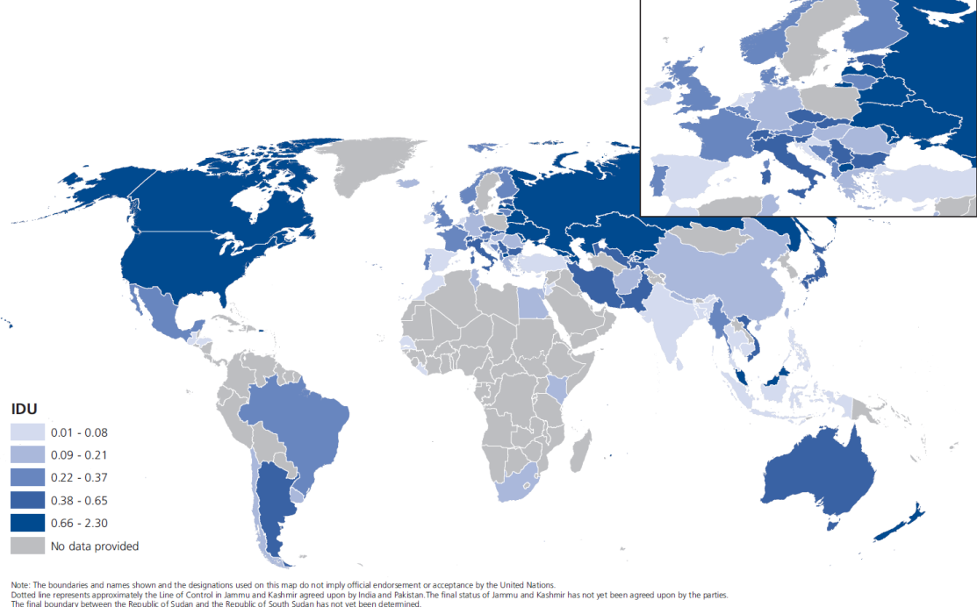
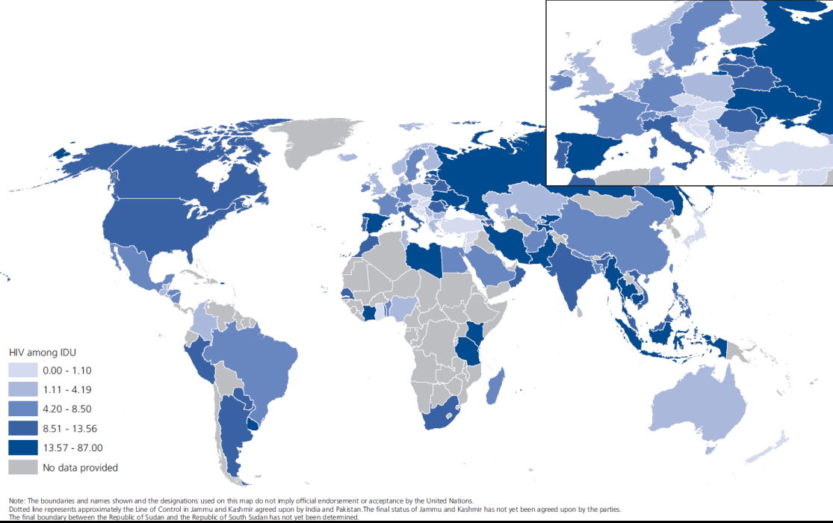
12.7 million people who inject drugs (0.27 % prevalence)
People who inject drugs
HIV among PWID
1.7 million PWID living with HIV (13.1% of PWID)
Notes:
Presenting for the first time joint WHO, UNODC, UNAIDS, WB estimates of people who inject drugs and are living with HIV.
Derived through extensive consultations within the 4 organisations as well as with external experts in different regions
Estimated 12.7 million people who inject drugs (0.27 % prevalence)
Highest rates in Eastern/South Eastern Europe (1.26%) and Central Asia and Transcaucasia (0.76%)
In terms of the actual numbers of people who inject drugs, three countries Russian Federation, China and the United
States combined account for 46 per cent of the global total.
1.7 million PWID living with HIV (13.1% of PWID)
Highest rates of HIV among PWID in South West Asia (28.8%) and Eastern/South Eastern Europe 923.0%)
In terms of the actual number of people who inject drugs living with HIV, four countries combined (China, Pakistan,
the Russian Federation and the United States) account for 62 per cent of the global total.
52% of PWID also have HCV

Slide 2
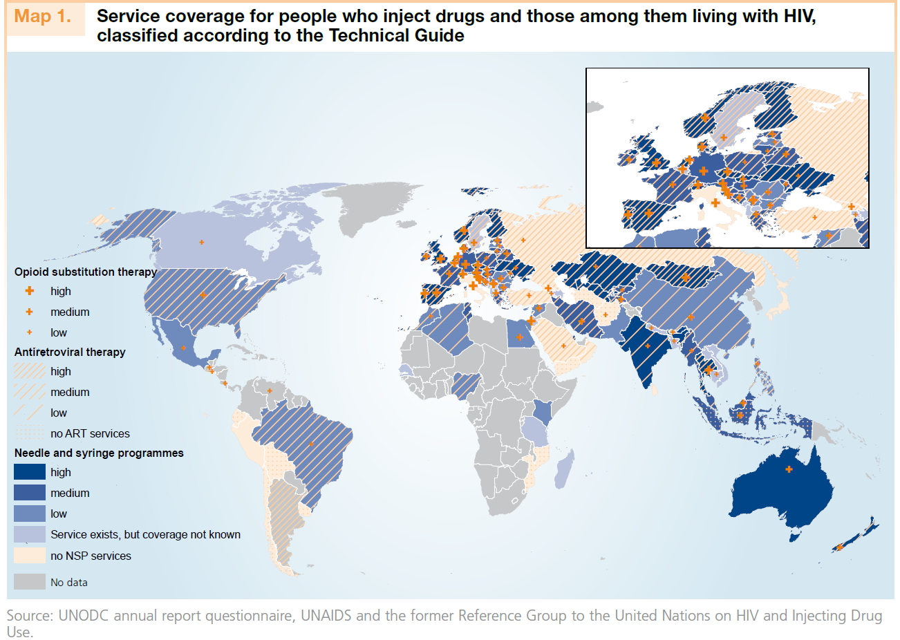
Notes:
A comprehensive package of nine evidence-based interventions, for the prevention, treatment and care of HIV among people who inject drugs has been widely endorsed by all stakeholders.
Of them, the four most effective interventions for HIV prevention, treatment and care are needle and syringe programmes,
opioid substitution therapy, HIV testing and counselling, and antiretroviral therapy.
The coverage of the four most effective interventions is greatest in Western and Central Europe, where harm reduction interventions have been scaled up for more than a decade, leading to a decline in the number of newly diagnosed cases of HIV among people who inject drugs and of AIDS-related deaths attributed to unsafe injecting drug use.
In most other countries, the extent of services provided to people who inject drugs falls below the lower-level targets presented in the Technical Guide.

Slide 3
Levels of service provision for countries with high numbers of PWD and living with HIV
Notes:
In the 16 high prevalence countries — which account for 45% of the global number of people who inject drugs and 66 per cent of the global number of people who inject drugs living with HIV —a generally low level of service provision can be noted, particularly with regard to the needle and syringes distributed per person who injects drugs per year, as well as generally the needle and syringe, and programmes and opioid substitution therapy.
These countries include: Belarus, Canada, Georgia, Indonesia, Kazakhstan, Latvia, Malaysia, Myanmar, Pakistan, Republic of Moldova, Russian Federation, Spain, Tajikistan, Thailand, Ukraine and United States.

Slide 4
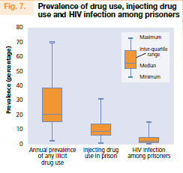
Prisons
Notes:
UNODC presenting data on drug use and HIV in the prisons for the first time in the World Drug Report
Drug use including injecting drugs are highly prevalent among prison populations – often more than in the general population.
In the limited number of countries that have reported data in the prison the prevalence of drug use ranges between 2 – 70 percent among the prison population, whereas between less than 1 and 31 per cent reported injecting in the prison.
HIV prevalence in prisons in most of the low and middle income countries found to be greater than 10 per cent.
Although there are fewer women in prison, both drug use and HIV infection are more prevalent among women in prison than among imprisoned men

