Slide 1
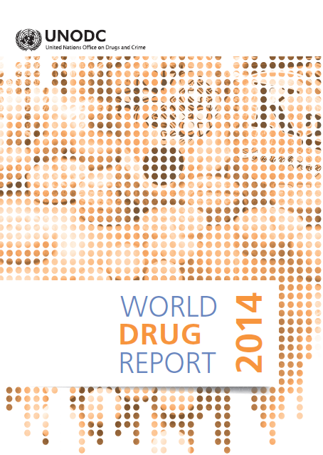

Slide 2
Global Drug use
Notes:
Overall trends in drug use remained stable with 162 and 324 million people using an illicit substance in 2012 – 5.2% of the population aged 15-64 years
Extent of problem drug use also remained stable between 16 and 39 million problem drug users
Since 2009, globally there has been an increase in opioid and cannabis use
Use of opiates cocaine and ATS remained stable or follow a decreasing trend
Different trends are observed in the different regions.
Drug related deaths – between 95,000 – 225,900 drug related deaths were reported in 2012 a rate of 40 per million population aged 15-64.

Slide 3
Criminal Justice Process
Recording of offences (arrests/suspects)
Investigation
Prosecution
Conviction
Prison

Slide 4
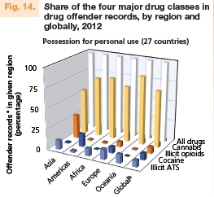
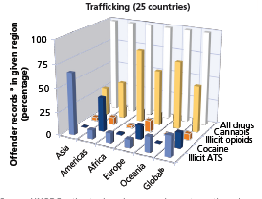
Drug-related crime
Over the period 2003-2012, the annual global proportion of drug users that was arrested for possession for personal use has fluctuated between 3 and 4 per cent
Cannabis is the most prominent drug in offences for possession for personal use.
For trafficking offences, ATS is the prominent drug in Asia and cocaine in the Americas
Notes:
According to available information, during 2003-2012, both the number of persons arrested/suspected for possession for personal use and the number of users of illicit drugs increased: the former group by 31 per cent and the latter by approximately one fifth.
Over the period 2003-2012, the annual global proportion of drug users that was arrested for possession for personal use has fluctuated between 3 and 4 per cent.
Suggesting that the increase in crime rates for possession for personal use was due to the increase in the total number of drug users.
Cannabis is clearly the most prominent drug in cases of offences for possession for personal use. For trafficking offences, the picture is different with ATS being the prominent drug in Asia and cocaine in the Americas.

Slide 5
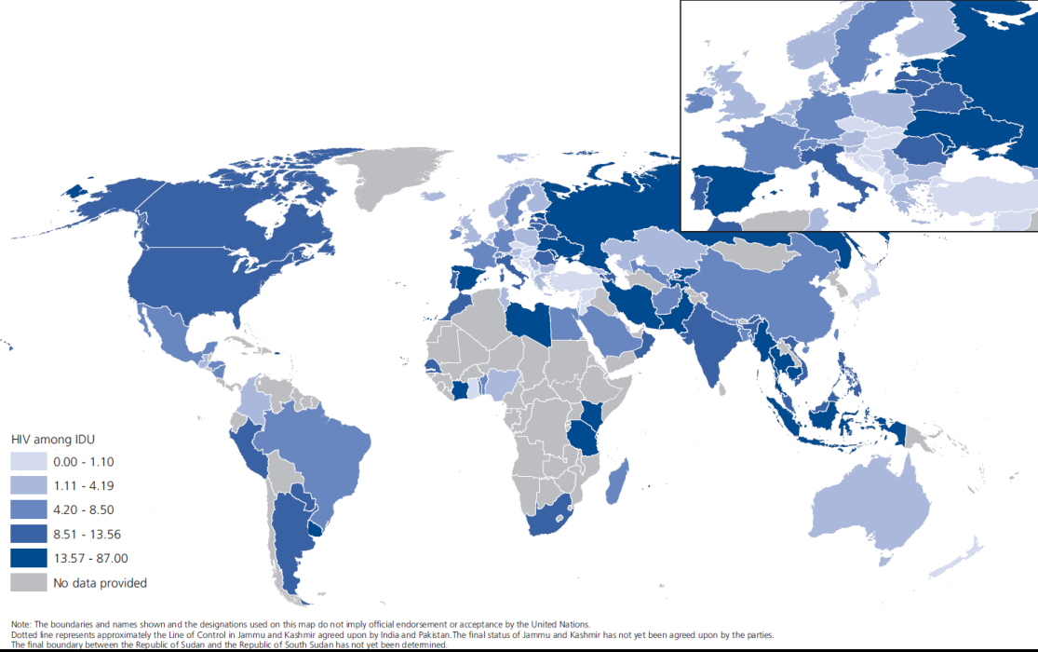
People who inject drugs 12.7 million people who inject drugs (0.27 % prevalence)
Joint UNODC-UNAIDS-WHO-WB estimates
HIV among PWID
1.7 million PWID living with HIV (13.1% of PWID)
Notes:
Presenting for the first time joint WHO, UNODC, UNAIDS, WB estimates of people who inject drugs and are living with HIV.
Derived through extensive consultations within the 4 organisations as well as with external experts in different regions
Estimated 12.7 million people who inject drugs (0.27 % prevalence)
Highest rates in Eastern/South Eastern Europe (1.26%) and Central Asia and Transcaucasia (0.76%)
In terms of the actual numbers of people who inject drugs, three countries Russian Federation, China and the United
States combined account for 46 per cent of the global total.
1.7 million PWID living with HIV (13.1% of PWID)
Highest rates of HIV among PWID in South West Asia (28.8%) and Eastern/South Eastern Europe 923.0%)
In terms of the actual number of people who inject drugs living with HIV, four countries combined (China, Pakistan,
the Russian Federation and the United States) account for 62 per cent of the global total.
52% of PWID also have HCV

Slide 6
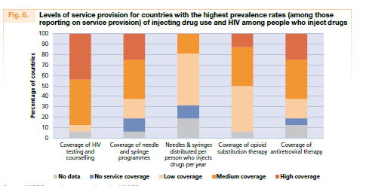
Notes:
A comprehensive package of nine evidence-based interventions, for the prevention, treatment and care of HIV among people who inject drugs has been widely endorsed by all stakeholders.
Of them, the four most effective interventions for HIV prevention, treatment and care are needle and syringe programmes,
opioid substitution therapy, HIV testing and counselling, and antiretroviral therapy.
The coverage of the four most effective interventions is greatest in Western and Central Europe, where harm reduction interventions have been scaled up for more than a decade, leading to a decline in the number of newly diagnosed cases of HIV among people who inject drugs and of AIDS-related deaths attributed to unsafe injecting drug use.
In most countries, the extent of services provided to people who inject drugs falls below the lower-level targets presented in the Technical Guide. However, global estimates mask important regional variations.
In the 16 high prevalence countries — which account for 45% of the global number of people who inject drugs and 66 per cent of the global number of people who inject drugs living with HIV —a generally low level of service provision can be noted, particularly with regard to needle and syringe programmes and opioid substitution therapy.

Slide 7
Opiate seizures
Notes:
Globally, seizures of heroin and illicit morphine went down 19 per cent in 2012.
The main declines in opiate seizures were reported in South-West Asia and Western and Central Europe, where seizures declined by 29 per cent and 19 per cent respectively.
A substantial increase in heroin seizures was reported in Eastern and South-Eastern Europe (15.98 tons in 2012 compared with 9.88 tons in 2011), mainly as a result of increased quantities reported seized in Turkey. The flow of heroin along the long-established Balkan route, from Afghanistan to Western and Central Europe via Iran (Islamic Republic of ) and Turkey, has declined in recent years, but there is evidence of alternate routes developing the so called Southern route – possibly via Middle East and Africa as well as directly from Pakistan.
Heroin seizures also increased substantially in Australia and New Zealand (1.09 tons in 2012 compared with 0.61 tons in
2011) and in South Asia (1.3 tons in 2012 compared with 0.723 tons reported in 2011).
In North America, heroin seizures declined by 58 per cent in Mexico but increased in the United States, to 5.5 tons in 2012

Slide 8
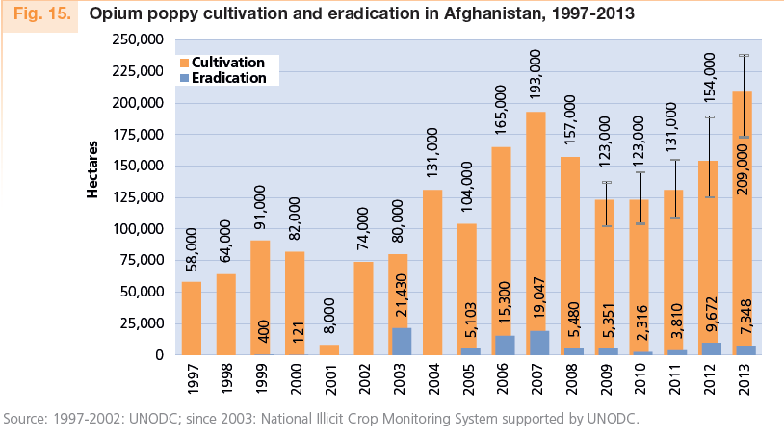
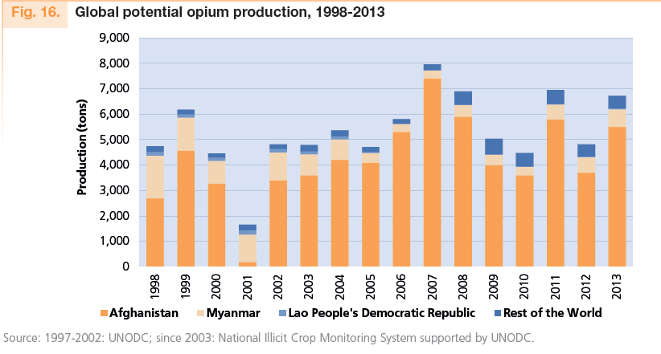
Opium cultivation and production
Notes:
The global area under opium cultivation in 2013 was 296,720 hectares highest level since 1998
Main increase in opium cultivation was observed in Afghanistan – 36% from 2012. Though not as pronounced, opium cultivation in Myanmar also continue to increase - a trend that began after 2006.
The global potential production of opium is estimated at 6,883 tons – a return to levels observed in 2011 or 2008. Opium production in Afghanistan accounts for 80% of global opium production.
The potential production of heroin has also increased to 560 tons comparable with 2008 estimates

Slide 9
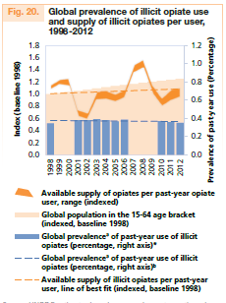
Stability of the opiate global market
Notes:
In spite of the apparent complexity and the fluctuations in key supply indicators, a long-term perspective (taking 1991 as a starting point) reveals some elements of stability in the underlyning fundamental indicators at a global level.

Slide 10
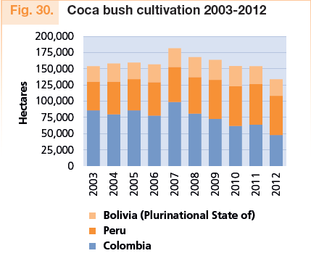
Coca cultivation and production
Notes:
Coca bush cultivation continued to decline in 2012 – totalled to 133,700 ha – a decline of 14% and lowest levels since beginning of available estimates in 1990
Main Decline observed in Columbia – 25%
Consequently estimated global production of cocaine also declined – e.g, in Columbia the potential production of pure cocaine was estimated at 309 tons – lowest since 1996.

Slide 11
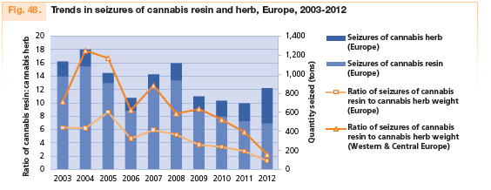
Changes in cannabis market in Europe
Notes:
Whereas cannabis resin had previously dominated the market, now there are nearly equivalent levels of resin and herb seizures, implying a continuing shift away from imported resin coming mainly from Morocco to more locally or regionally produced cannabis herb.

Slide 12
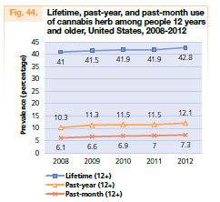
Cannabis market in the US
Notes:
In major consumer markets, treatment enrolment and hospitalizations related to cannabis use have been increasing. In the United States, between 2006 and 2010, there was a 59 per cent increase in cannabis-related emergency department visits and a 14 per cent increase in cannabis related treatment admissions. Additionally, according to the Potency Monitoring Project of the University of Mississippi, levels of tetrahydrocannabinol (THC) in seized or eradicated cannabis herb crops in the United States increased from 8.7 per cent in 2007 to 11.9 per cent in 2011.

Slide 13
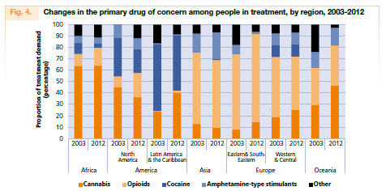

Slide 14
Changing cannabis policy in the Americas
INCB position
Details, design and implementation of the new laws vary significantly
Need for monitoring and evaluation
Health
Increase in prevalence from recreational use sale expected , but need to look at the health impact and possible substitution effects
Criminal justice
Not easy to assess, there are data on persons apprehended for possession for personal use, but no data to show what happens after in terms of prosecution, conviction and imprisonment
Economic costs and benefits
Notes:
The International Narcotics Control Board has expressed concern that “a number of States that are parties to the 1961 Convention are considering legislative proposals intended to regulate the use of cannabis for purposes rather than medical and scientific ones” and it urged “all Governments and the international community to carefully consider the negative impact of such developments.”
Although in those three jurisdictions, the purchase, possession and consumption of cannabis are now legal, the details, design and implementation of the new laws vary significantly. For example, in Uruguay users must register in a database to monitor cumulative purchases (maximum 40 g per month), but in the State of Colorado, purchases of up to 1 oz (28 g) are allowed per outlet, with no central registry of cumulative purchases per buyer nor any limit on the amount that can be purchased each month.
Because laws of this kind have never before been enacted or implemented in a national or state jurisdiction, no previous case studies are available to predict what changes should be expected. Thus, monitoring and evaluation will provide critical data for policymakers. For this reason, it is important that the impacts of this legislation are measured against a number of factors, ranging from the impact on health and criminal justice (effects on the individual as well as institutions and society) to the balance of public revenues against costs and to other social impacts.
While research has not conclusively established the impact of more lenient laws on cannabis consumption, an increase in prevalence of cannabis use from recreational use sales is expected, although it is also possible that the primary effect – particularly in the first decade or so – may differ from longer-term impacts.
To estimate the overall criminal justice impact of increasingly permissive laws on cannabis is not an easy task. Laws regarding cannabis possession affect both the broader institutional criminal justice system and the individual.
Tax revenues from retail cannabis sales may provide significant revenue, although there is uncertainty concerning how much can be raised. in Uruguay and the states of Washington and Colorado, significant costs will also be incurred through the establishment of programmes to deter cannabis abuse and regulate the new industry. Based on assumptions regarding the size of the consumer market, it is unclear how legalization will affect public budgets in the short or long term, but expected revenue will need to be cautiously balanced against the costs of prevention and health care.

Slide 15
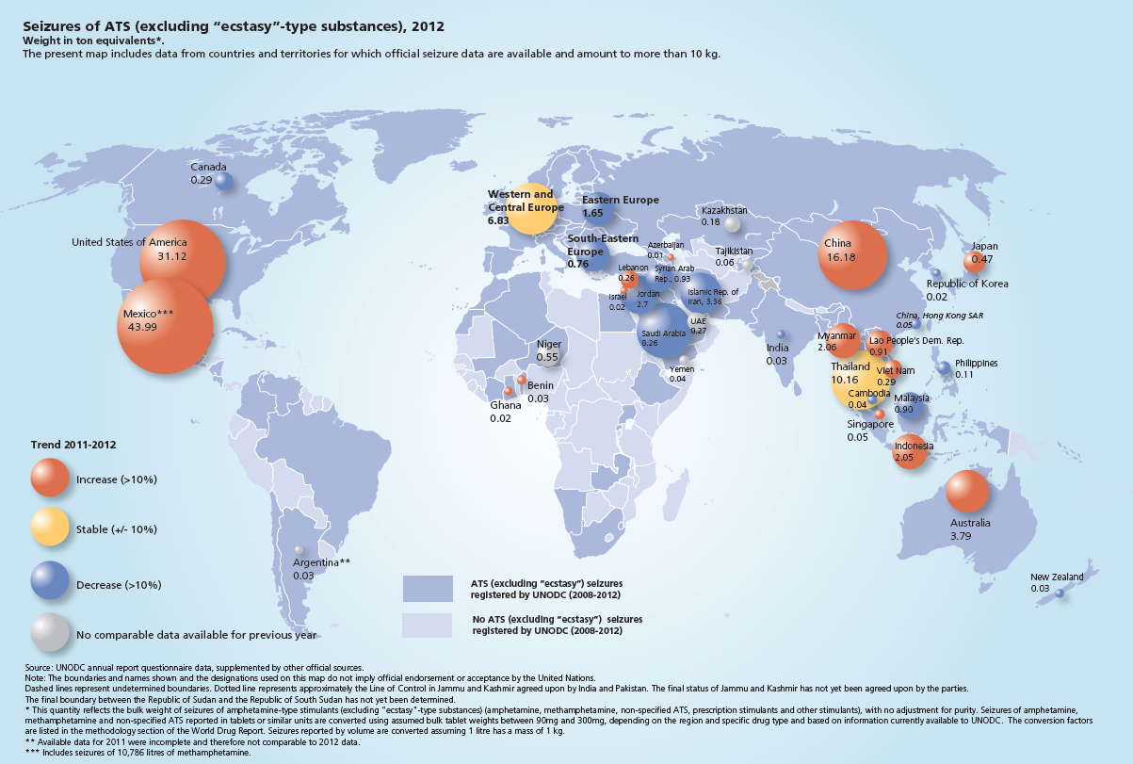
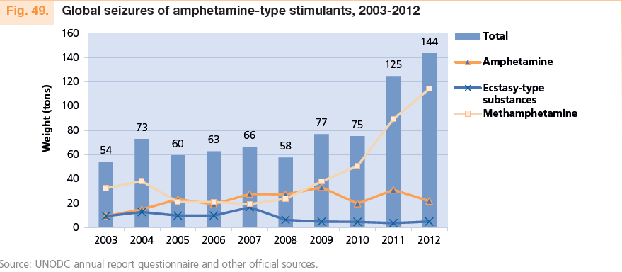
ATS seizures
Notes:
ATS seizures reached an all-time high of 144 tons, up 15 per cent from 2011, due in large part
to increases in methamphetamine seizures.
Over the past five years, methamphetamine seizures have almost quadrupled, from 24 tons in 2008 to 114 tons in 2012.
Of the total of 144 tons of ATS seized globally in 2012, approximately half were seized in North America alone and approximately a quarter in East and South-East Asia.
Large quantities of amphetamine seizures continue to be reported in the Middle East, in particular by Jordan, Saudi Arabia
and the Syrian Arab Republic.

Slide 16
Regional distribution of the value added of the global chemical industry, 1990-2010
Source: UNODC estimates based on World Bank, Indicators, August 2013.
Notes:
VULNERABILITIES
Over the past century, the chemical industry has been one of the main economic growth sectors, and it continues to
grow strongly, both in volume and in geographical terms, involving an ever larger number of players. This and the increasing number of intermediaries provide, however, greater opportunities for diversion.
The production output of the chemical industry, expressed in constant US dollars, almost doubled between 1990 and 2010, and rose more than fourfold between 1960 and 2010 to approximately $3,800 billion.
The value-added of the chemical industry – expressed in constant US$ - grew from $620 billion in 1990 to $1,110 billion in 201.
Click:
Over the 1990-2010 period the proportion of the value-added of the global chemical industry has been
- declining in the Americas,
declining and in Europe,
but rising in Asia.
Asia accounted
For 35% of global value-added of chemical industry in 2010,
for 44% of global production output in 2010 and
for even 52% of global sales of the chemical industry in 2011

Slide 17
Global exports of the chemical industry, 1990-2012
Growth in exports, output and value-added of the chemical industry (based on constant US$)
Sources: UNODC estimates based on World Bank Indicators, UNIDO Industrial Database and UN COMTRADE (SITC Rev.3).
Notes:
Chemical exports grew strongly in the 1990s and even stronger in the first decade of the new millenium following an ongoing trade-liberalisation and the broadening of the membership (China !) of the World Trade Organisation (WTO) at the beginning of the 21st century.
The value added of the chemical industry grew 3.5% per year over the 2000-2010 period. This was more than the growth of the value added of manufacturing as a whole (2.8% per year over the 2000-2010 period) and more than overall economic growth (2.5% per year over the 2000-2010 period).
Output of the chemical industry grew stronger than the value added.
Chemical exports grew stronger than the output of the chemical industry.
The observed stronger growth of output as compared to value-added suggests a trend of companies redefining their core products and spinning off non-core production and services to new companies. This can be explained by a reduced vertical integration of the chemical industry, mainly as a consequence of the emergence of new production sites in developing countries, particularly in Asia.
One side-effect has been increased intra-industry trade in chemicals across continents which increases the risk of diversion of chemicals used in the clandestine manufacture of drugs.
The risk is further exacerbated by a growing number of intermediary countries and brokers involved in the chemical trade.
In fact, 40% (!!) of the countries export more chemicals that they produce.
This means that there are nowadays important trade flows of chemicals that do not go directly from producing to consuming countries. Instead, they transit various countries before arriving in the final destination countries. The more brokers and other intermediaries are involved in the supply chain, the larger are the possibilities of diversion and the weaker will be the effective application of the ‘know your customer’ principle, set out in the 1998 Political Declaration and the related ‘measures to enhance international cooperation to counter the world drug problem’ .
Potential vulnerabilities of diversion of chemicals have been thus increasing over the last two decades, notably over the last decade.
The problem might have thus exploded if no precursor control at the national and international level had been put in place.

Slide 18
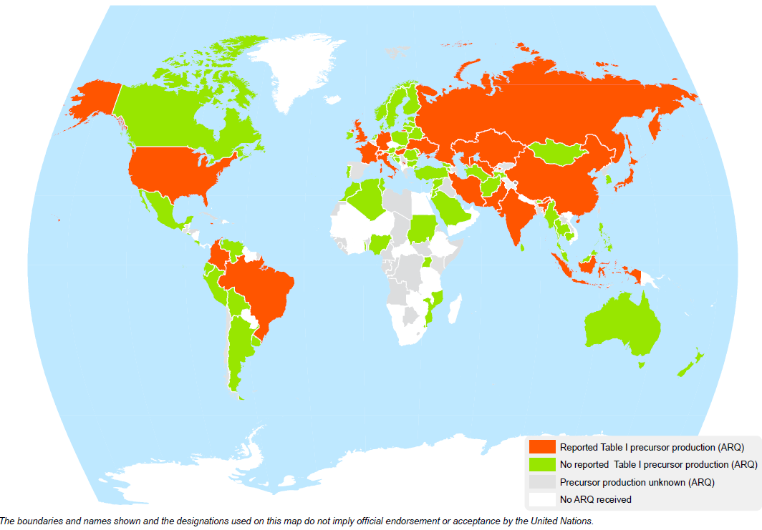
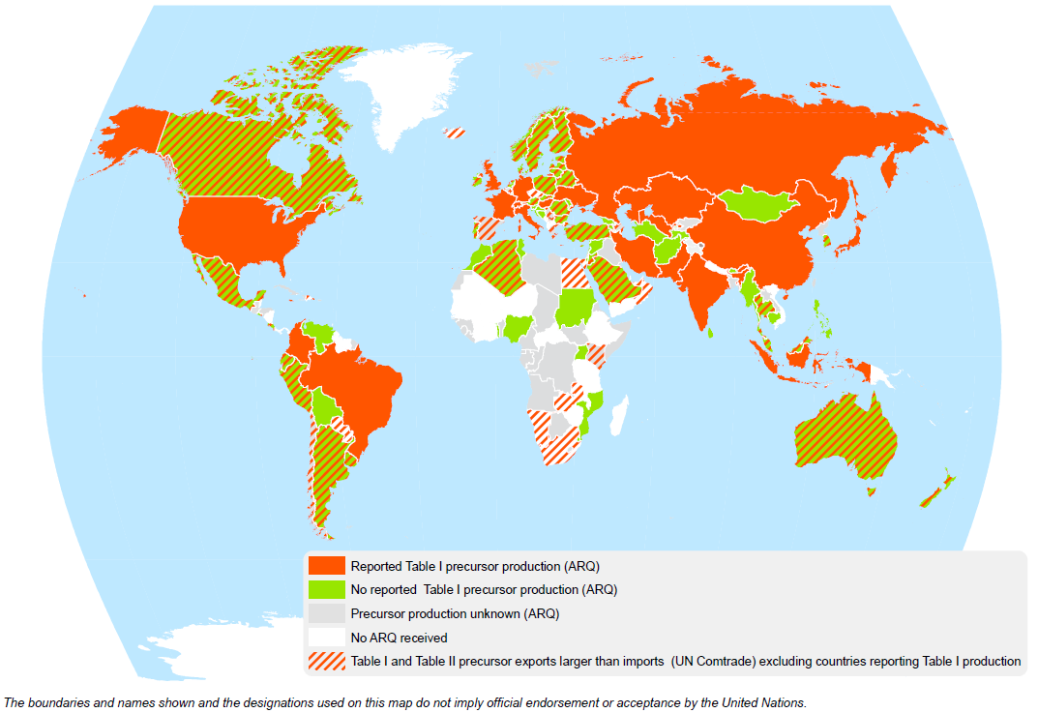
Potential manufacture of precursor chemicals (Table I and Table II), 2010-2012
20 countries officially reported manufacture of Table I precursors to UNODC over the 2010-2012 period
(8 in Asia, 8 in Europe and 4 in the Americas).
77 potential precursors producing countries account for 77% of the world population
Sources: UNODC, Annual Reports Questionnaire data and UN COMTRADE data.
Notes:
Countries asked in the ARQ on information of whether Table I precursors are produced in their country. 20 countries reported production over 2010-2012 period.
Third click:
Shaded line shows countries where exports of any specific precursor (out of 23 internationally controlled) exceeded imports over the 2010-2012 period); indirect indication of domestic production.
Including countries reporting Table I production.

Slide 19
Global (legal) exports of precursor chemicals in constant 2012 US dollars, 1996-2012
Change: 1996-2012:
Table I precursors: +35%
Table II precursors: 3½ times
Source: COMTRADE data.
Notes:
Growth in exports of the less controlled Table II precursor chemicals has been far larger than exports of the more controlled Table I precursors.
In 2012 exports of all precursor chemicals accounted for 0.5% of all chemical exports.
Table I precursors accounted for 7% and Table II precursors for 93% of all precursors exports.
The largest Table I exports were
acetic anhydride (used in the manufacture of heroin and of P-2-P out of phenylacetic acid, typically used in North America for meth production), followed by
potassium permanganate (used in the manufacture of cocaine),
pseudoephedrine (used in the manufacture of methamphetamine) and
piperonal (used in the manufacture of ecstasy).

Slide 20
Global seizures of Table I precursors, 1989-2012
*cocaine precursor: potassium permanganate; heroin precursor: acetic anhydride; amphetamine-type stimulants (ATS) precursors: P-2-P, phenylacetic acid, ephedrine, pseudoephedrine, norephedrine, 3,4-MDP-2-P, safrole, isosafrole, piperonal; others: lysergic acid; ergometrine, ergotamine, N-Aceylanthranilic acid
*preliminary data for 2012; data may still rise once additional information becomes available.
Source: INCB, 2013 Precursors report, New York 2014 (and previous years).
Notes:
The main growth of Table I precursors was linked to ATS precursors.
The peak in 2011 was primarily due to phenylacetic acid seizures in North America. Phenylacetic acid is used to produce P-2-P, which – in north America – is nowadays mainly used for the clandestine manufacture of methamphetamine.

Slide 21
Effects of precursor control
Seizures and stopped shipments
Seizures of Table I precursors: 12-fold increase 1990-92 and 2010-2012
Stopped precursors shipments even more important than precursors seizures
Additional measurements of ‘effectiveness’:
Interception rate (15% for diverted potassium permanganate and acetic anhydride over the 2007-2012 period)
Reduction of drug availability
Seizures of precursor chemicals compared to drug seizures
Seizures of ecstasy precursors: 18% more than ecstasy seizures (2007-2012);
Seizures of amphetamines precursors: > 2-fold seizures of amphetamine and meth-
amphetamine (2007-2012)
Cases of reductions in supply of drugs linked to precursors control:
LSD, methaqualone, ecstasy
Impact of precursor control on prices:
Licit: $1-1.5 per litre of acetic anhydride; Afghanistan: $8 in 2002; ≈ $200 ($157-$221) in 2013
Notes:
Note:
Stopped shipments:
Prime objective of precursor control are not precursor seizures but the prevention of diversion of precursor chemicals towards clandestine laboratories;
Thus 943,000 litres of acetic anhydride were either stopped or identified as suspicious, i.e. nearly double the 551,000 litres of acetic anhydride globally seized over the 2008-2011 period.
Seizures of precursor chemicals compared to end-products
The analysis of precursor seizures, expressed in end-product equivalents, shows that ecstasy precursor seizures over the 2007-2012 period exceeded ecstasy seizures by 18%;
Seizures of precursor of amphetamine and methamphetamine were even more than 2 fold the seizures of amphetamine and methamphetamine over the 2007-2012 period.
Cases of reduction
There are indications that in the case of LSD, methaqualone and ecstasy improved precursor control actually helped to reduce production.
In Europe, LSD use fell by ¾ over the last decade among young adults; similarly in the USA, LSD prevalence fell by 75% among 12th grade high-school students over the 1996-2013 period; this appears to have been linked to falling availability. Perceived availability of LSD fell 54% among 12th grade students over this period. Global exports of the main LSD precursors (lysergic acid, ergotamine and ergometrine) fell by 78% over the 1996-2012 period).
Use of ecstasy fell by almost half in Europe over the last decade in the USA it fell 58% among 12th graders between 2000 and 2013; this went hand in hand with a decline of perceived availability of 32%. Overall exports of ecstasy precursor at the global level fell by 41% between 1998 and 2012.
Prices
Prices of acetic anhydride in Afghanistan rose from $8 per litre in 2002 to more than $430 in 2011 before declining – for best quality acetic anhydride to $221 in 2013 or overall $157 (average of all acetic anhydride of all qualities across Afghanistan).
- The rise in prices over the 2002-2011 period can be linked to improvements in precursor control.
- The fall in prices between 2011 and 2012/2013 may be linked to a fall in global seizures in 2012 and a deteriorating security situation which facilitates smuggling of acetic anhydride into Afghanistan.
Nonetheless, prices are still far higher than the licit prices of acetic anhydride of $1 to $1.5 per litre.

Slide 22
Reactions of clandestine operators
More sophisticated ways to obtain precursor chemicals
Creation of specialized groups to obtain the precursors chemicals
Creation of front companies
Identification of weak links in the control system
Identification of weaknesses at the national level (diversion from domestic sources)
Use of the Internet
Use of pharmaceutical preparations (containing ephedrine and pseudoephedrine)
Use of substitute chemicals and pre-precursors (APAAN, esters of phenyl-acete (ethyl phenylacete, methyl phenylacetate), 3,4-MDP-2-P methyl glycidate, methylamine, etc.)
Production of New Psychoactive Substances (NPS)
Notes:
Reactions:
The fact that clandestine operators reacted to international precursor control is an indirect proof that it has an impact and is being taken seriously.
Use of pharmaceutical preparations:
Such preparations have been de-facto exempted from international control in the 1988 Convention.
Only in subsequent resolutions and in the 2009 Political Declaration and its Plan of Action countries were encouraged to include
controls to such substances as well.
Use of substitute chemicals and pre-precursors:
Examples: APAAN (pre-precursors); used to manufacture P2P, a precursor for the manufacture of amphetamine (in March 2014 CND decision to schedule).
Other examples have been esters of phenylacete (ethyl phenylacete, methyl phenylacetate) which were widely used in Mexico and Central America to produce phenylacetic acid, for the manufacture of P-2-P which was then used for the manufacture of methamphetamine.
An identified ecstasy pre-precursor has been 3,4-MDP-2-P methyl glycidate (produced out of piperonal) which is then used to produce 3,4-MDP-2-P – the ‘traditional’ precursor for MDMA.
Another widespread precursor is methylamine which – combined with P-2-P is used for the manufacture of methamphetamine or, combined with 3,4-MDP-2-P can produce ecstasy. Global seizures of methylamine in 2012 (197 tons and 208,000 litres), mostly done in North America and Central America, already exceeded several times the combined total of ‘traditional’ ATS precursor seizures (less than 50 tons in 2012).
NPS
No international controls of NPS and even less for their precursors. Relatively little international trade of precursor chemicals for NPS so-far; often produced in East Asia out of locally legally available precursors; in this case NPS are internationally traded rather than their precursors).

Slide 23
Conclusions
Potential vulnerabilities of diversion of precursor chemicals increased over the last two decades
Nonetheless, progress has been made in precursor control since the 1988 Convention was adopted
Challenges are arising from new strategies adopted by operators of clandestine laboratories, notably the use of non-controlled ‘substitute precursors‘
Some of the instruments (international legal requirements) already exist:
‘limited international special surveillance list’
diversion of non-scheduled substances for clandestine manufacture made a ‘criminal offence’
pre-export notifications for non-scheduled substances and pharmaceutical preparations
participation in the PICS, including for non-scheduled substances
… but are still awaiting global implementation

Slide 24
THANK YOU
FOR YOUR ATTENTION
For more information: http://www.unodc.org/

