Slide 1
Education for Justice (E4J)
Integrity and Ethics
Module 2: Ethics and Universal Values

Slide 2
Agenda
Universal Values: Definitions (45 minutes)
Universal Declaration on Human Rights (UDHR) (45 minutes)
Enacting universal values (45 minutes)
Universal Declaration of Human Values (45 minutes)
Summary (10 minutes)

Slide 3
Learning Outcomes
Upon completion of this module students should be able to:
Understand the ideas of values, ethics, and morality in a multicultural context
Understand how universal values can be uncovered by different means, including scientific investigation, historical research, or public debate and deliberation
Understand and discuss the idea of moral relativism and the challenges it poses to universal values

Slide 4
Learning Outcomes II
Upon completion of this module students should be able to:
Critically assess the relationship between theory and practice in the formulation of values
Understand that values arise from lived experiences, but need to be justified to others
Understand the role of deliberation and debate in framing such values
Understand how to create an actionable document through such a process

Slide 5
Universal Values: Definitions
What is a universal value?
What is a value?
What is it to say that a value is universal?
How do values relate to ethics and morality?
Are there any universal values?

Slide 6
Universal Values: Definitions
Valuing things is based on human needs
Valuing behaviours arises from things we value
But more than one behaviour can attain an end
For example, I value peace as a state of being
Behaviour 1: I will not harm others
Behaviour 2: I will build up my defences so as not to be harmed
Which will achieve what I value better?

Slide 7
Universal Values: Definitions
What does Universal mean?
Universal = all human beings
Universal = all cultures
Universal = all religions
Universal = all legal and political systems

Slide 8
Universal Values: Definitions
Universal values as behaviours
Do not harm others
Do not cheat others
Do not lie to others
Do not enslave others
Universal values as things
Peace
Justice
Equality
Freedom
Beauty
Joy

Slide 9
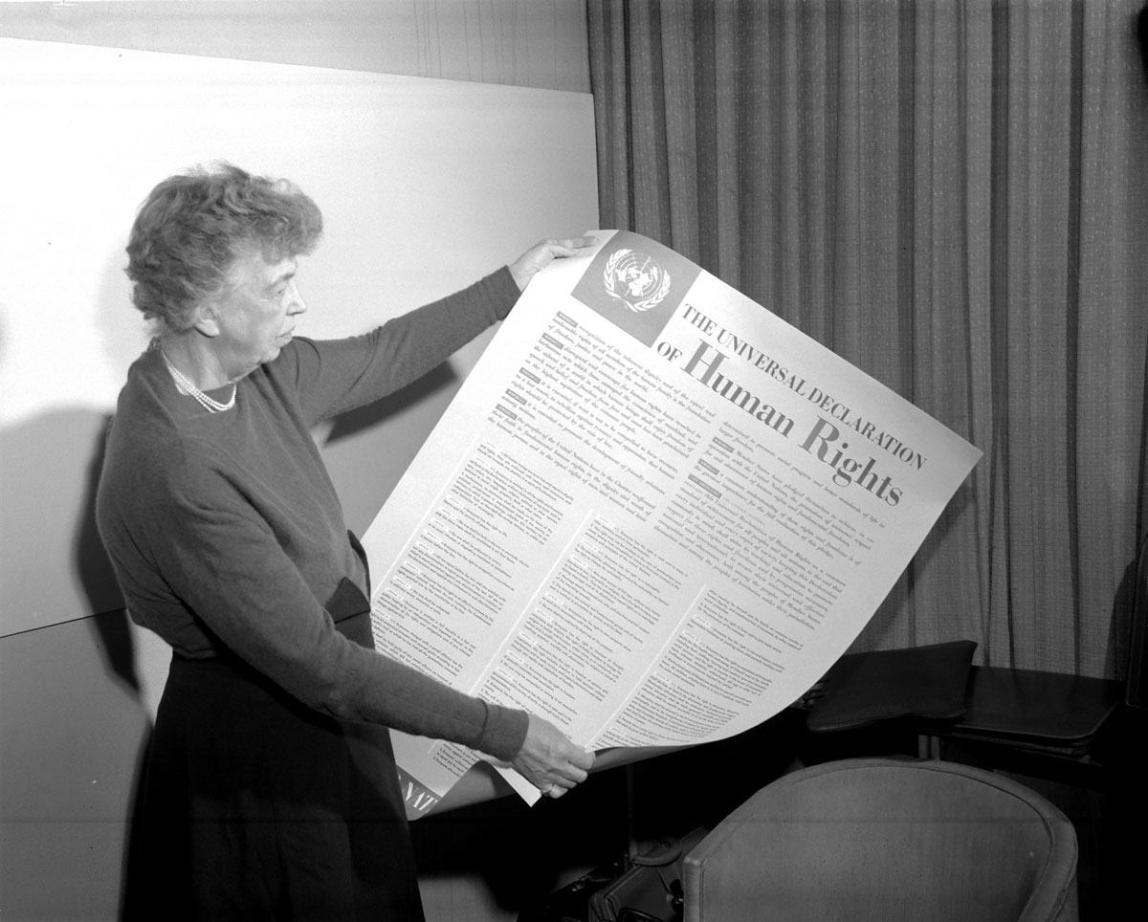
Universal Declaration on Human Rights (UDHR)
Proposed by UN General Assembly 1946
Economic and Social Council tasks Commission on Human Rights to formulate declaration
Commission creates committee of 8 members to draft document, chaired by Eleanor Roosevelt
UNESCO solicits views from international scholars
Adopted by the UN General Assembly December 1948

Slide 10
Universal Declaration on Human Rights (UDHR)
‘It is related that at one of the meetings of a UNESCO National Commission where Human Rights were being discussed, someone expressed astonishment that certain champions of violently opposed ideologies had agreed on a list of those rights. “Yes,” they said, “we agree about the rights, but on condition that no one asks us why.” That “why” is where the argument begins.’
Jacques Maritain, ‘Introduction’ Human Rights: Comments and Interpretations
(UNESCO, 1948)

Slide 11
Universal Declaration on Human Rights (UDHR)
Rights without foundations?
Rights or duties?
Universal or lowest common denominator?

Slide 12
Enacting universal values (exercise)
E1: Performance
Team 1 PEACE
Team 2 FREEDOM
Team 3 SOCIAL PROGRESS
TEAM 4 EQUAL RIGHTS
TEAM 5 HUMAN DIGNITY

Slide 13
Universal Declaration of Human Values (exercise)
E2: Creating a Universal Declaration of Human Values
What do you value?
How can what you value be turned into a rule of behaviour?
What areas of life are most important to delimit in such a document, i.e., politics, law, economics, society, family, etc.?

Slide 14
Core reading
The following entries in the Stanford Encyclopedia of Philosophy:
The Definition of Morality (https://plato.stanford.edu/entries/morality-definition/)
Moral Particularism and Moral Generalism (https://plato.stanford.edu/entries/moral-particularism-generalism/)
Aristotle (https://plato.stanford.edu/entries/aristotle/)
Mencius (https://plato.stanford.edu/entries/mencius/)
Habermas (https://plato.stanford.edu/entries/habermas/)
Universal Declaration on Human Rights:
Universal Declaration of Human Rights http://www.un.org/en/universal-declaration-human-rights/index.html.
UNESCO. Human rights: comments and interpretations: http://unesdoc.unesco.org/images/0015/001550/155042eb.pdf.
Brown, Gordon, ed. (2016). The Universal Declaration of Human Rights in the 21st Century. Open Book Publishers.
Annan, Kofi. Speech on Universal Values: https://www.un.org/press/en/2003/sgsm9076.doc.htm
Parliament of World Religions. Declaration toward a Global Ethic: https://parliamentofreligions.org/pwr_resources/_includes/FCKcontent/File/TowardsAGlobalEthic.pdf
The Carnegie Council for Ethics in International Affairs:
Norms, Morals and Ethics (https://www.carnegiecouncil.org/education/002/normsmoralsethics)
Global Ethics Corner (https://www.carnegiecouncil.org/education/008/GEC)

