Slide 1
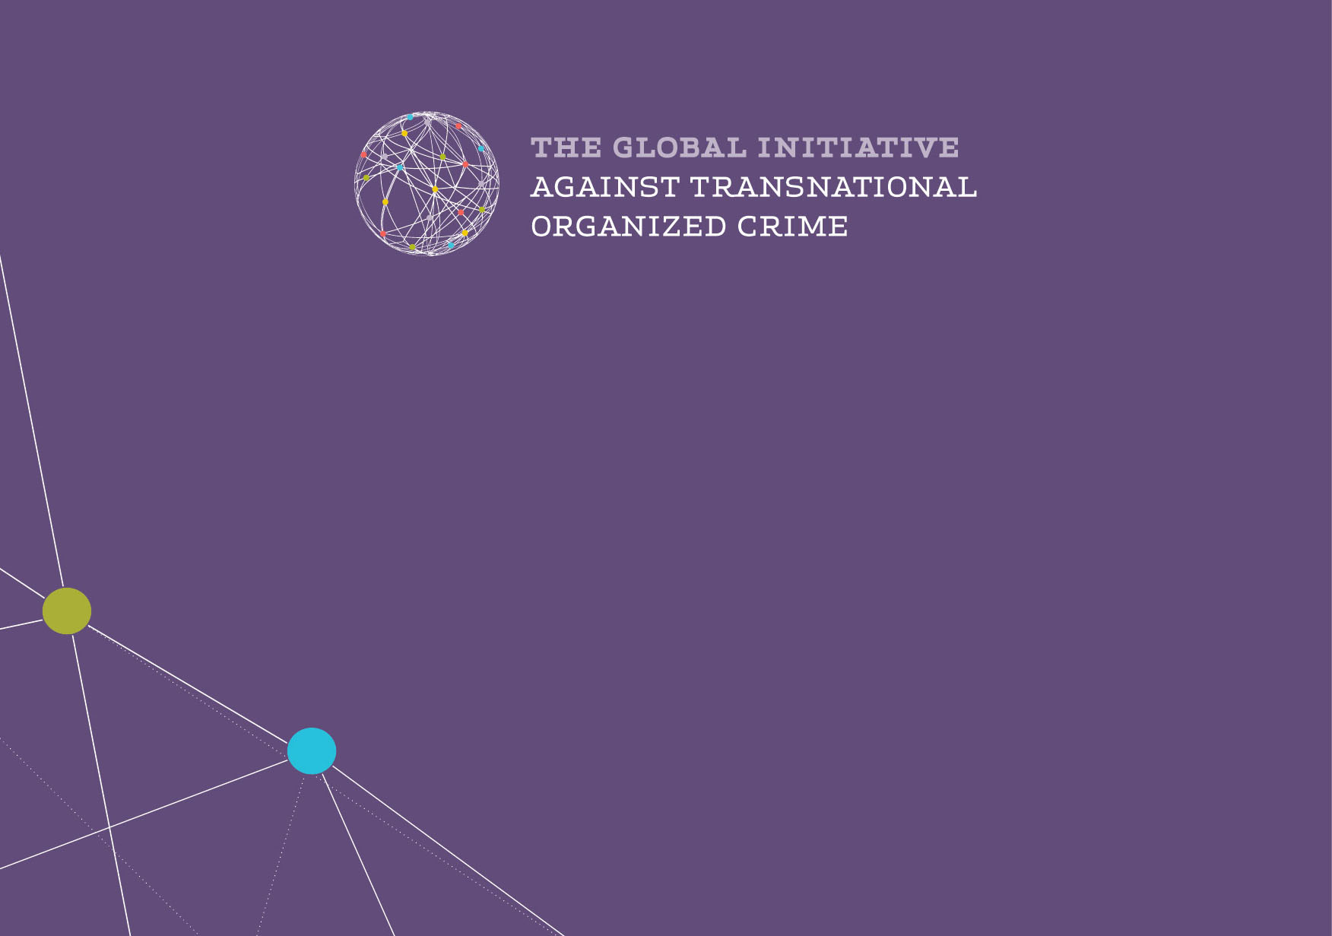
SUSTAINABLE DEVELOPMENT GOALS:
Challenges by organized crime
and corruption
Ambassador Dr. Ugliesa Zvekic, Senior Advisor
www.globalinitiative.net

Slide 2
Extent
Organized crime is not new but scale and scope have changed
New forms and methods of legitimization
Shifts in major illicit markets
Expansion of new criminal markets and demand for new commodities
Blurring of traditional producer, consumer and transit state typologies
Impact

Slide 3
Geopolitics of Transnational Criminal Flows and Markets
Suppliers of criminal flows: not anymore mostly from developing world and countries in transition
Receivers: not only North America and West/Central Europe; Asia
BUT
Geopolitical equilibration of suppliers and receivers of illicit capital flows, money laundering, corruption, organized crime

Slide 4
Legalization & Legitimization
Legitimization of the illicit activities, status and profits as the strategy of the OC/TOC
Increased organized corruption both as a means and an end in itself
Increased presence of OC in the management and political authority structures to influence and control the process of legalization and legitimization of illicit flows and gains
Corruption as a mean for legalization of illicit flows

Slide 5
Developmental Uses of Organized Crime and Corruption
NOT ONLY BY TERRITORIAL AND COMMODITY CONTROL
BUT
“TRADING IN INFLUENCE” with PUBLIC ADMINISTRATION and PRIVATE SECTOR

Slide 6
Organized crime /Corruption and Developmental Platform
Organized crime/Corruption have broader implications than traditional security and justice framework
Organized crime and Corruption are now recognized as cross-cutting threats to sustainable development

Slide 7
Development Impact Areas
Sustainable Livelihoods
Health and Well-Being
Economy
Environment
Stability, Justice and Governance

Slide 8
Goal 16.2: Child abuse
Goal 8.7: Forced Labour
Goal 10.7: Orderly Migration
Goal 5.2: violence against women
Forced
Labour
Sustainable Livelihoods
Illegal
Migration
Sex
Trafficking
21m victims of forced labour generate US$150bn in annual profits (US$99bn from sex trade)
Child labour in 2013: 168m total (10.6% of all children in the world), 85m in hazardous jobs
Sex trafficking worth over US$3bn per year in Eastern Europe alone

Slide 9
Goal 3.3: Epidemics – HIV/AIDS
Goal 3.5: Substance Abuse
Goal 3.3: Epidemics
Goal 3.5: Substance Abuse
Goal 2.1: End Hunger
Goal 2.3: Increase Agricultural Productivity
Goal 2.5: Maintain Genetic Diversity
Illicit
Drug Use
Fake
Meds
Health and Wellbeing
Illicit
Tobacco
Food Crimes
60% or more of medicine in vulnerable countries is falsified.
US$5.7 billion worth of fake pesticides sold every year globally
10% of all new HIV infections caused by injecting drugs (one of leading causes of new cases)

Slide 10
Goal 15.7: Poaching and trafficking
Goal 14.4: Illegal Fishing
Goal 6.3: Illegal dumping of toxic waste
Flora & Fauna
Environment
IUU
Fishing
Illegal dumping
Over 800 kg of fish illegally caught every second, with annual value of US$1.02 trillion
Illegal fishing threatens to cause complete collapse of global fish stocks by 2048
Illegal wildlife trade worth US$5-20bn annually (2014 est.)
Illegal toxic waste disposal in Italy generates US$21-26bn annually in profits

Slide 11
Goal 16.4: Illicit financial flows
Goal 10.5: Financial Markets
Illicit Financial Flows
Economy
Transfer
Mispricing
Global illicit trade worth est. $3.3 trillion in 2011 (10% of world GDP)
Illicit outflows from Africa 1980-2009: US$1.2-1.4 trillion
25% of the value of all imports to the Philippines goes unreported (2014 est)

Slide 12
Goal 11.3: Urbanization
Goal 16.1: Violent Death
Goal 16.4: Arms Trafficking
Goal 16.5: Corruption and Bribery
Goal 16.6: Integrity of Institutions
Goal 16.6: Integrity of Institutions (democracy)
Conflict & Violence
Stability, Justice and Governance
Corruption
Other threats
All seven of the countries which are unlikely to meet a single MDG by 2015 are countries that have been affected by high levels of violence
At least 650m small arms in civilian hands worldwide, 42-60% of all lethal violence committed with small arms

Slide 13
Maximising the post-2015 Agenda
SDGs provides a policy platform and agenda within which a number of international goals and instruments related to illicit arena may be realized and implemented to reduce the negative developmental impacts of organized crime in consonance with positive values of human development within the framework of internationally accepted human rights and rule of law paradigm

Slide 14
www.globalinitiative.net

