Slide 1
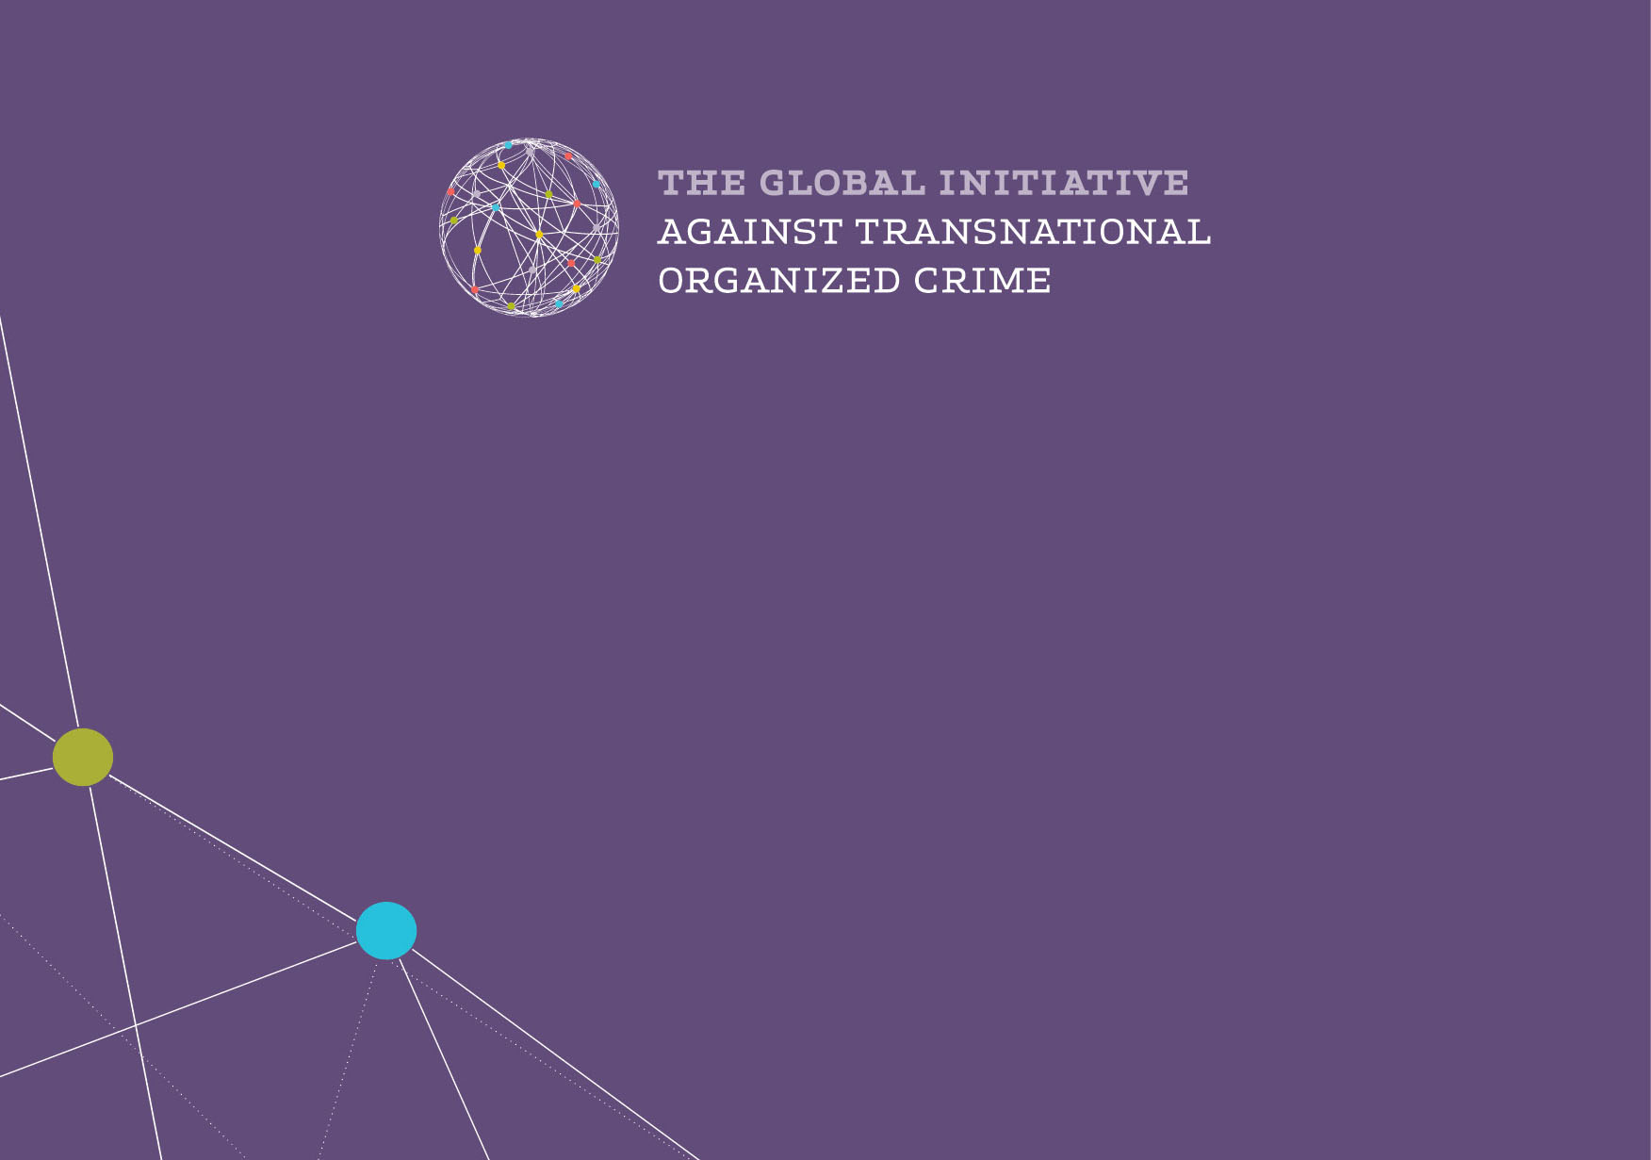
MAFIA IN THE ETERNAL CITY
a Profile of a Network of Organized Crime and of Administrative Corruption for New Business Opportunities
Maurizio Fiasco, Researcher and Consultant of Public Security and Gambling Problem; Expert of the National Anti-Usury Council
www.globalinitiative.net

Slide 2
Open Issues
What is «Mafia Capitale»?
Why so Much Interest in It?
What is the Structure of this Phenomenon?
New Context Variables
Implications for Policies
Institutional Measures

Slide 3
1. The “Mafia Capitale” Paradigm
What is “Mafia Capitale”
“Mafia Capitale” is a network including criminals, former terrorists, corrupt public officials and political representatives
Unlike “historical” mafias (such as Cosa Nostra, 'Ndrangheta and Camorra) it is not a clan between blood relatives, but an association of individuals to commit crimes without fanfare
The links between bosses and soldiers are utilitarian
“Mafia Capitale” however, has used the methods of the mafia and pursued typical mafia objectives:
It has bribed politicials and government officials
It has organized a business in Italy that had never been implemented before by Italians : the exploitation of the condition of thousands of foreigners refugees , immigrants or asylum seekers
“It's a combination of criminal factors as well as institutional, historical and cultural factors alltogether outlining a peculiar profile, at the same time original and autochthonous”
[Giuseppe Pignatone, Public Prosecutor in Rome]......

Slide 4
1.2 Similarities and differences from traditional mafia ../..
Similarities
“Intimidating force resulting from the peculitarity of the association bond and the subjection condition as well as the conspiracy of silence”
“Crimes such as Extortion, Usury, Money laundering, Corruption of public officials…”
“…So as to acquire, directly or indirectly, management and control of economic activities, concessions, authorizations, contracts and public services."
[Giuseppe Pignatone, Public Prosecutor in Rome]......

Slide 5
1.2 Similarities and differences from traditional mafia ../..
Differences
Very flexible organization that generated a “middle world”
Relational space for different environments : common criminals , entrepreneurs rigged contracts , economic and financial crime
Appropriate framing to interact without confusion of roles

Slide 6
1.3 The assets of “Mafia Capitale”
The Roman judiciary has confiscated the accused
850 real estates (buildings, landholdings, construction sites, industrial plants).
600 goods and chattels
340 commercial enterprises
The total value is 1 billion euro
Main areas of business
Public Service Contracts, Economic Crimes, Waste Disposal
“First level” crimes
Extortion, usury, robbery, drugs dealing

Slide 7
1.4 Three archetypal leaders
B
A murderess in jail and then "redeemed, rehabilitated, pardoned by the President of the Italian Republic"
Once awarded freedom, he exploits the degeneration factors of the Italian political class
The behaviour of Italian political class can be interpreted by the concept of differential association , anomie, and pathological narcissism
C
He has a biography as common criminal and fascist terrorist
He was trained in the 80s by the militias during the civil war in Lebanon
He operated at the service of major subversive plots in Italy
His psychological profile is marked by the omnipotence as for common criminals who join neo-fascism (as described in The Authoritarian Personality (1)
A
When he was young he played a role in the extremist neo-fascist movements. He was also in prison provisional and later acquitted. Thirty years later he became mayor of Rome
¹ Adorno, Frenkel-Vrunswik, Levinson, Sanford, NYC 1950

Slide 8
1.5 “Mafia Capitale” Innovation: business to the detriment of refugees and people persecuted for political, ethnic or religious reasons
“Mafia Capitale”
has retained a substantial share of state funding given by the Government for hospitality and assistance to refugees and ethnic minorities
has exploited the immigration of suffering and persecuted people

Slide 9
1.6 Refugees: three times victims
In the country of origin: persecution and violence
On the run: smuggling, organized by groups of raiders
In the host country: violation of human dignity

Slide 10
2.1 Exploitation of refugees and ethnic minorities
Why so much interest
From shore to shore of the Mediterranean
Profiting directly: network of smuggling
Profiting indirectly: misappropriation of financial resources allocated by the Italian Government to face the emergency
Consequences:
High costs and very bad accomodations
Very bad household
Ghettos for minorities

Slide 11
2.2 Operational tools ../..
Permanent organization of violence
Reaching social acceptance and approval:
Leadership of groups of football hooligans
Taking advantage of emergencies:
Blackmailing of local governments

Slide 12
2.2 Operational tools
Engaging social cooperatives and fake non-profit organizations
Bypassing regular employment procedures
Obtaining public contract services
Supplying money to politics
Restraining emergencies

Slide 13
3.1 The “Middle World” as an “enterprise network”
The structure of the phenomenon
«This is the theory of the “Middle World”. The livings and the deads, above and below. We are in the middle. In the “Middle World” all of them meet together. In the “Middle World” it is possible that I find myself at dinner with a politician»
[M. Carminati, boss of the bosses]
Relationship and criminal co-operation
«Upper World»: the political class
«Under World»: criminality
«Middle World»: Mafia Capitale
cooperates and provides services to the “Upper World” through political corruption, violence , intimidation and illegal wealth produced by the “Under World”
a mixture of corruption and violence

Slide 14
3.2 Resources of “Mafia Capitale”
Operates in a co-ordinated and finalized way, from decision making to management and execution
Ensures compliance of the secret contract with the stated terms
Does not invade the media and allows politicians to promote own public image
Feeds the electoral consensus both from inside (selection of candidates , primary elections etc.), both from outside (managing votes in the elections)
Provides services for money laundring of back funds produced by criminal activities and tax evasion.

Slide 15
4.1 The new variables
New Context Variables
The management of “emergencies” by the Government without controlled procedures produces monopoly markets, for example:
Day-after natural disasters (earthquakes, floods).
Environmental risks (waste disposal, etc. )
Accidents (i.e. industrial accidents, etc.)
Geopolitical events (wars, immigration, refugees, etc.).

Slide 16
5.1 Deregulation and opportunities for crime
Implications for Policies
The measures for managing "emergencies" are decided and implemented outside controlled and guaranteed procedures
“Strong men”, Problem-Solvers, come on stage and operate through extraordinary mandate
Special networks are formed that propose “packaged” solutions
Refugees have no channel and no way to express or describe their actual condition to care givers
The sentiment of public opinion is fear

Slide 17
6.1 The State against corruption
Institutional Measures
To prevent corruption:
Transparency and publicity of procedures and contracts
Selection of the political class and effectively mobilization of the public opinion
Provide effective legislation to regulate the activity of political parties
Set limits to the collection of money destinated to the activities of politicians
Restore the rule of law through democracy and the free exercise of criticism

Slide 18
6.2 A double track for public control
Judiciary , i.e. legality
Political, i.e. representative
Accountability and Responsibility of the Public Administration
Selection and protection of legitimate interests

Slide 19
THANK YOU FOR YOUR ATTENTION
maurizio.fiasco@gmail.com

