Slide 1
Local Power Networks –
Linkage between Politics and Crime
Manzoor Hasan, Barrister-at-Law
Chair, UNCAC Coalition
Executive Director, South Asian Institute of Advanced Legal & Human Right Studies

Slide 2

Happy New Year
Notes:
SHUBO NOVOBORSHO – first day of the Bengali calendar and wish you all a very peaceful and prosperous new year

Slide 3
Rana Tragedy
April 24, 2013 - Rana Plaza collapsed
Trapping 1000s of workers - over 1,100 people died
Owner of the building, Sohel Rana, a main culprit
Street-level political & criminal figure
Shady dealings in acquiring the land & construction rights & well known land grabbing & connection with politics
Cracks emerging in support pillars
1000s of workers forced to enter the building, with horrific consequences
Notes:
Most of you probably remember the tragic incident two years ago – 24th April 2013 – which resulted in the death of 1,100 people & many more injured. This became known as the Rana Plaza disaster, which triggered this study of local level state of governance. Who is Rana? How could he influence so many people to construct such a factory? His relationship with the local administration, MPs and other influential people. Rana is known as a mastaan – a local power broker – a mafia. Today I will presenting a section of this study, which will soon be released as a book.
On April 24, 2013, an eight-story building named Rana Plaza collapsed in the middle of the day, trapping thousands of workers – mainly from the garment factories inside. In the end, despite large-scale rescue efforts to pick through the rubble, over 1,100 people died. As the world became aware of what would become one of the largest industrial disasters in history, stories emerged of the owner of the building, Sohel Rana, who was one of the main culprits of the tragedy. A street-level political and criminal figure, he was the right hand man of the then Member of Parliament. Alongside his shady dealings in acquiring the land and construction rights for Rana Plaza, he was well known for his land grabbing and other criminal activities. The day before the collapse, despite cracks emerging in support pillars and a government engineer warning of the instability of the building, he insisted on television there was no problem and that all workers should return to work. The businesses and thousands of workers complied with this directive, with horrific consequences.

Slide 4
Politics and Governance
Since 1991 Parliamentary form of government
Despite Bangladesh’s impressive performance (economic & social indicators)
Governance has been poor – corruption, weak rule of law, institutional weaknesses, politicization & growing electoral violence/state impunity
‘Big Picture’ political economy analysis is inadequate – doesn’t give us the full story
Need to undertake micro-level studies
Notes:
This study has to be seen in the overall context of Bangladesh’s state of governance. Since 1991 Bangladesh has been governed by elected governments after years of military and semi-military governments. Bangladesh is known for its paradoxes – generally a poor country known for its natural disasters but has done extremely well in terms of the various indicators of the MDGs. But the governance indicators are very depressing – a decade ago Bangladesh was the one of the most corrupt according to TI’s CPI. Many studies have been done to study Bangladesh’s transition but enough focus has not been given to the micro-level situation.

Slide 5
Overview of Research
Understand local power structures
Focus on mastaans (‘mafia’) – local power brokers
Try to understand micro-level corruption, its network, electoral/political violence and distribution of benefits from economic growth using a variety of methods
Research analyses a variety of data – secondary & primary: perpetrators & victims; process & linkages
Notes:
So, through this study we try to understand the local level power structure and focus on the mastaans – local power brokers. Try to understand corruption …… through the lens of mastaans. This presentation will give you the result of a survey….

Slide 6
Politicians, Mastaans & Governance: A Survey of Journalists on Local Power Structures
Research Design
Survey of journalists
7 constituencies (from 7 Divisions), randomly selected for each division of Bangladesh
Variety of contexts: peri-urban, rural, border town, coastal
Notes:
Research design – briefly mention

Slide 7
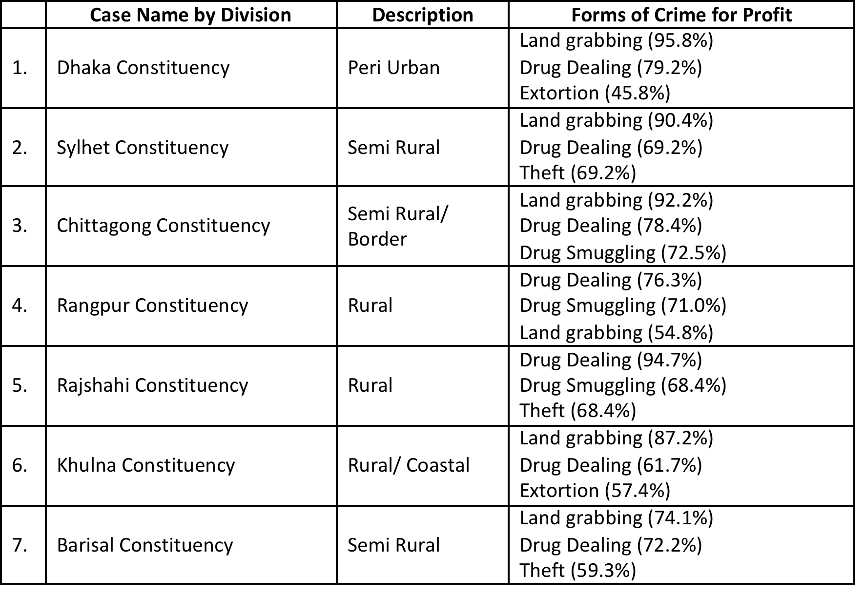
Top forms of economic crimes: land grabbing and drug dealing
Notes:
Note: Options included Land Grabbing, Drug Dealing, Drug Smuggling, Extortion, Theft, Garment Leftovers, Arms Smuggling, Violence for Hire.
Note: the percent indicates the portion of journalists who recognized the area of crime as among the top three most common in the constituency.
The most profitable forms of ‘crime for profit’ are land grabbing and drug dealing. As you will see from the next slide politicians and mastaans are heavily involved in land grabbing, while politicians, the police and mastaans dominate the drug dealing in the constituencies. Land that is grabbed is most commonly khas land, i.e., government owned land. When such land is taken, it is generally used for shops, with housing also mentioned frequently. Agricultural use is the third choice. Bangladesh is experiencing a huge pressure on land given its population size of 160 million and economic transition and urbanisation.

Slide 8
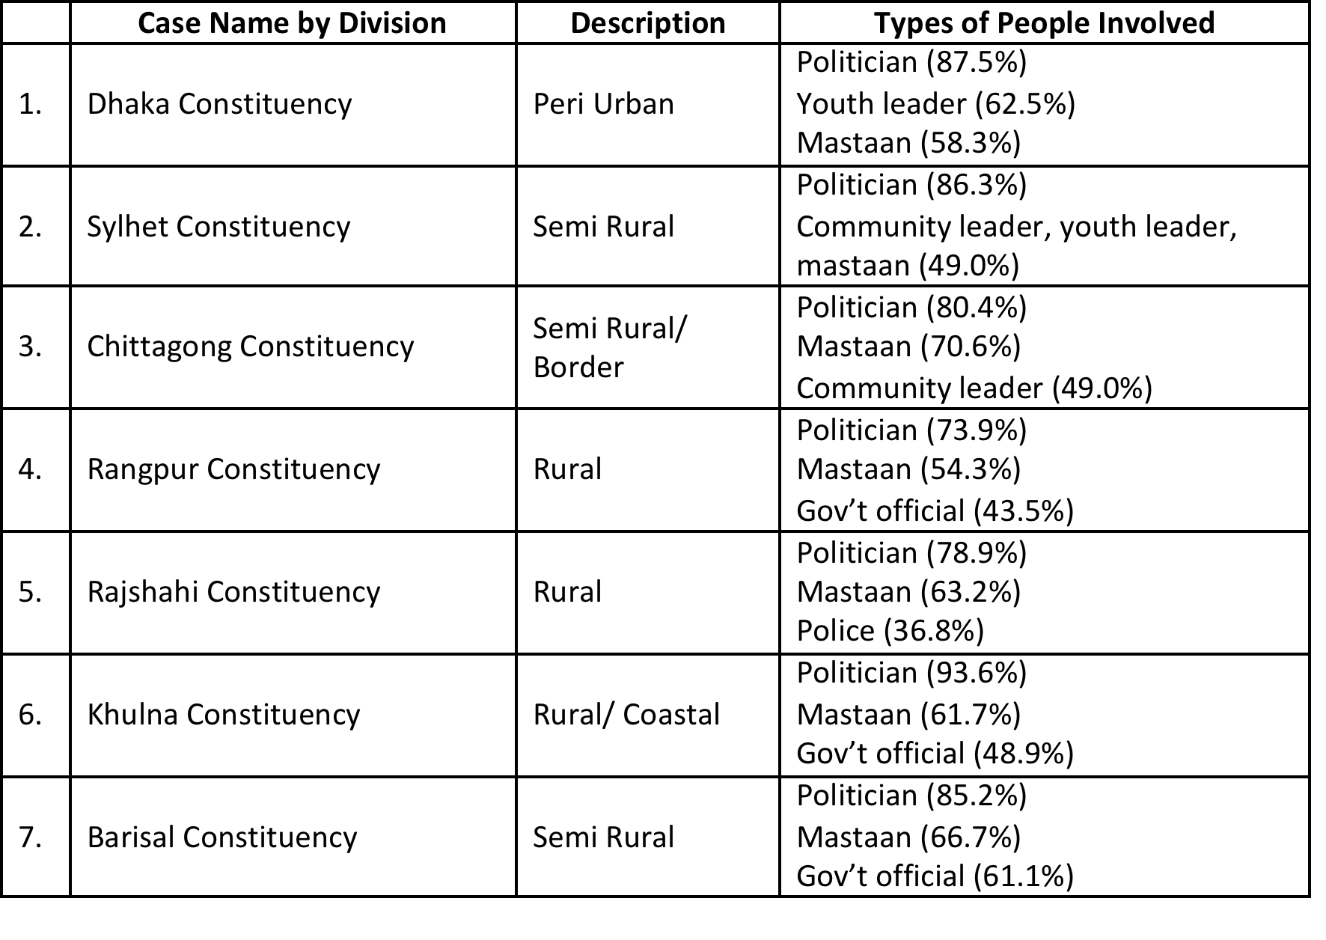
Top individuals involved in land grabbing include politicians and mastaans
Notes:
Politicians and mastaans are heavily involved in land grabbing. The table presents the top three selections of journalists in the constituencies in terms of groups who participate in grabbing land. In every case, the politicians is the most recognised individuals, which likely relates to the fact that khas land is most commonly grabbed. Mastaans are similarly identified in their role in land grabbing.

Slide 9
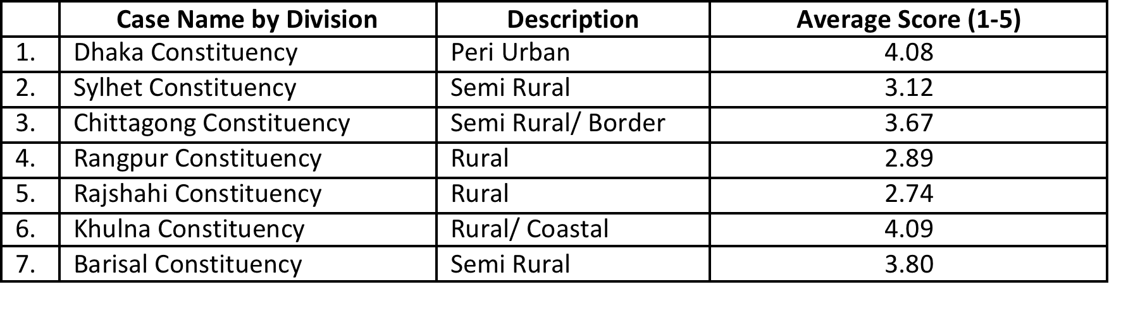
Variation in the level of mastaan power, correlated with local economies
Notes:
This table shows the average rating by journalists for the level of mastaan power in the constituency. The data ranges from 2.74 to 4.09, where 2 is a bit powerful, 3 moderately powerful and 4 is very powerful. 1 stands for ‘not powerful at all’ and 5 meaning ‘extremely powerful’.
Dhaka constituency is a peri-urban area of Dhaka, with a booming population. Therefore, housing prices have increased dramatically, leading to the need for land to be used for apartment complexes. Large companies moving in, cooperating with local power structures to grab land from middle class and poor farmers, with little or no compensation. Threats of violence, and occasional violent acts from politically affiliated mastaans, is used to ensure the submission of land owners. Scores 4.08
Khulna constituency is on the coast and a major producer of shrimp for export, a relatively highly valued commodity. See extensive land grabbing as a result. The land being grabbed is often owned by local politicians. Due to threats of violence, these local politicians and their associates often flee the area when the rival political group takes power for fear of violence from mastaan figures, leading to a grabbing of their land. As a result, the same land has been passed between different political groups. Scores 4.09

Slide 10
Broad Conclusions - 1
Mastaans play a major role
Focuses on two areas: crimes for profit & electoral violence
Crimes for profit - land grabbing, drug dealing and extortion - three most common and profitable crimes for profit at the local level in our study areas
Notes:
Several broad conclusions emerge from the research. First, mastaans play a major role in the local socio political life across the variety of cases presented in this research. Their role, however, generally focuses on two areas: crimes for profit and electoral violence, and not patronage. Within crimes for profit, they are especially involved in land grabbing, drug dealing and extortion, which for the most part are the three most common and profitable crimes for profit at the local level in our study areas.

Slide 11
Broad Conclusions - 2
Some notable variation across cases
One distinct area of variation is the level of mastaan power. Varies from area to area
Such variation is not recognized in the literature on mastaan-ism in Bangladesh due to the limited research at the local level on the topic
Notes:
Second, there is some notable variation across cases. One distinct area of variation is the level of mastaan power. Such variation is not recognized in the literature on mastaan-ism in Bangladesh thus far, due to the limited research at the local level on the topic. There is also an enormous variation in MP wealth, as well as the increases in MP wealth over time.

Slide 12
Broad Conclusions - 3
In relatively small number of constituencies wealth of MPs has increased dramatically, in others little increase
Mastaan power is greatest where economic opportunities are unique with local actors using mastaan power in order to exploit those opportunities
Notes:
Third, putting insights from the three empirical sections together, this article develops a hypothesis to explain the level of mastaan power and increases in MP wealth that depends on the economy of the locality suggesting that mastaan power varies across cases. Suggests that in a relatively small portion of constituencies, the wealth of MPs has increased dramatically, while in others there has been little increase. Section looks at the context of constituencies in which mastaan power is greatest, and finds that the economic opportunities are unique in these contexts, with local actors using mastaan power in order to exploit those opportunities. These growth areas fostered an unprecedented profitability of land investment, leading to strong-arm tactics often led by local politicians to grab land. Such interests using violence flourished in the context of weak institutions and rule of law.

Slide 13
Broad Conclusions - 4
Use of mastaan power is correlated with extensive use of violence in local politics, such as, murder and mass beatings
In some instances, the same local actors involved in both areas - economic and political; these actors tended to be local politicians
Due to secretive nature of such activities, difficult to establish the precise involvement of higher-level politicians
Local informants insisted that higher-level politicians were involved & even directing many of these activities
Notes:
The use of mastaan power is correlated with the extensive use of violence in local politics as well, such as murder and mass beatings. In some instances, the same local actors were clearly involved in both areas, the economic and political; these actors tended to be local politicians. Due to the secretive nature of the activities, though, it was difficult to establish the precise involvement of higher-level politicians. Local informants, when not afraid to speak, insisted that they were involved and even directing many of these activities.

Slide 14
3 Working Papers
Politicians, Mastaans and Government: A Survey of Journalists on Local Power Structures
The Nexus of Mastaans and Politicians in Land Grabbing and Political Violence: Two Case Studies on Local Power Structures
An Analysis of Bangladeshi Member of Parliament Asset Declaration Forms of 2008 and 2013
Notes:
Full title of the three papers

Slide 15
http://research4action.com/
Thank You
Fellow Researchers
Dr. Jonathan Rose
&
Sultan Mohammed Zakaria
Notes:
Check out the website for the full papers - thanks

