Slide 1
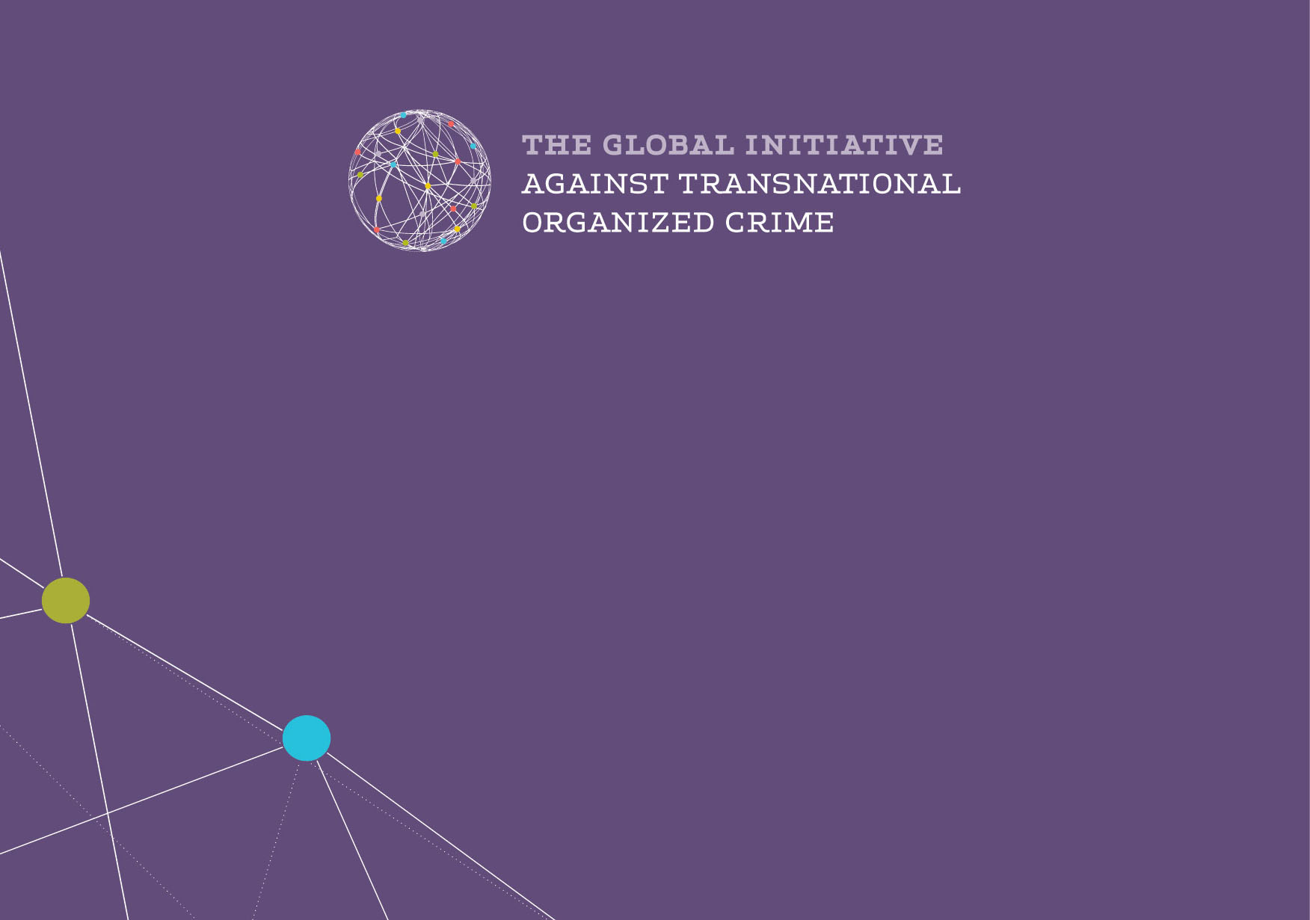
DIRTY ENTANGLEMENTS
Illicit Links between Organized Crime, Corruption and Terrorism
Louise Shelley, Hirst Chair and Director of Terrorism, Transnational Crime Center, SGPIA,
George Mason University
www.globalinitiative.net

Slide 2
Corruption and Crime
Transnational crime and corruption can exist alone
Terrorism is increasingly dependent and closely entangled with crime and corruption
Almost no terrorist group today not funded by crime
Terrorists are functioning like diversified criminal businesses
Kleptocrats drain resources undermining possibility of development and creating fertile ground for criminal and terrorist recruitment
The Challenge of these three elements is increasingly pernicious to regional and global stability and undermines the possibility of development

Slide 3
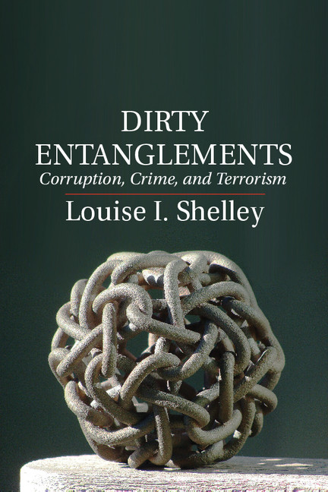
Book addresses complexity and rationality of ties

Slide 4
The Business of Terrorism
UN has recognized that terrorism is supported by crime and terrorism in Resolution 2195 In December 2014, and recognized this specifically in relation to ISIS in Resolution 2199 –in 2015
Citing of many offenses in these resolutions reveals recognition that terrorist groups function like diversified international criminal businesses with commodities and complex financial flows

Slide 5
Crimes linked to Terrorism—UN Res. 2195
Terrorists now derive their income from many less risky forms of illicit trade than drugs
UN resolution 2195 identifies these following categories of criminal activity funding terrorism—
“trafficking of arms, persons, drugs, and artifacts and from the illicit trade in natural resources including gold and other precious metals and stones, minerals, wildlife, charcoal and oil, as well as from kidnapping for ransom and other crimes including extortion and bank robbery”

Slide 6
UN Resolution on ISIS funding---Resolution 2199 Feb. 2015
ISIS resolution is focused not only on the crimes that generate funds for ISIS
Focuses on direct and indirect trade as well as trade-based money laundering that supports ISIS
Responsibility of states to counter financial supporters of terrorism
Concern with facilitation of trade and commodities used to move money
The problem that the UN identifies –the link of crime and terror has been found on all continents, but is particularly problematic in conflict regions

Slide 7
Focus on Illicit trade
Terrorists choose to fund their activity through many of the least policed forms of crime—counterfeits—(clothing, pharmaceuticals), antiquities, cigarettes, petty fraud, stolen telephones, low level intellectual property crime
These petty forms of illicit trade have high profit and low rescue
Dependent on enforcement capacity in many signatory countries of the United Nations
Recent terrorist attacks in France illustrative of this trend of terrorism funded by small scale crime, limited or no attention paid to these offenses by French authorities

Slide 8
Criminal funding of terrorism transcends borders and often regions
The products or people may originate in the developing world but their use or exploitation may occur in the developed world
Certain forms of illicit trade identified by UN particularly undermine sustainability and human development--human trafficking and smuggling, mining and trade in metals, wildlife
Much attention now to cybercrime but enumerated traditional crimes can do much harm

Slide 9
Dual-Use Crime
Criminals commit crime to make profits
Terrorists often commit crime because it causes multiple harms as well as makes money
A) Drugs—keep people subservient or incapacitates communities
B) Kidnapping—devastation of community makes them unable to resist
C) Trafficking for sex-vanquishes community such as Arch of Titus in Rome

Slide 10
Other Consequences of this Crime
Harmful to development—economic, environmental and sustainability of the planet, health (discussed in Zvekic presentation)
Instability undermines possibility of foreign investment, instability results from capital flight by corrupt leaders and economic elite and is also a cause of further capital flight
Youth can not then find legitimate employment in economies with no funds for development, highly corrupt environments deter business creation and growth

Slide 11
Implications
Terrorists must be thought of now more as groups that operate as criminal business using and capitalizing on corruption
Terrorism undermines stability and development not only through its use of violence but also through its promotion of criminal activity
Strategies to promote development must deal with all three components of the deadly problem

Slide 12
Strategies
Development strategies must include not only efforts to provide employment but must combat these diverse and pernicious forms of illicit trade
Oversight of foreign aid money and projects is key to prevent diversion to corrupt officials and pernicious non-state actor
Need effective and comprehensive laws such as know your customer and your supply chain
This is not just a law enforcement strategy and regulatory approach
Requires cooperation with business, citizen groups raising awareness on problematic supply chains, harms of counterfeits
Raising awareness of problems of illicit trade and consequences—effective journalism, civic engagement
Need research to understand trends and risks
Need whole of society perspective

